Slide 1
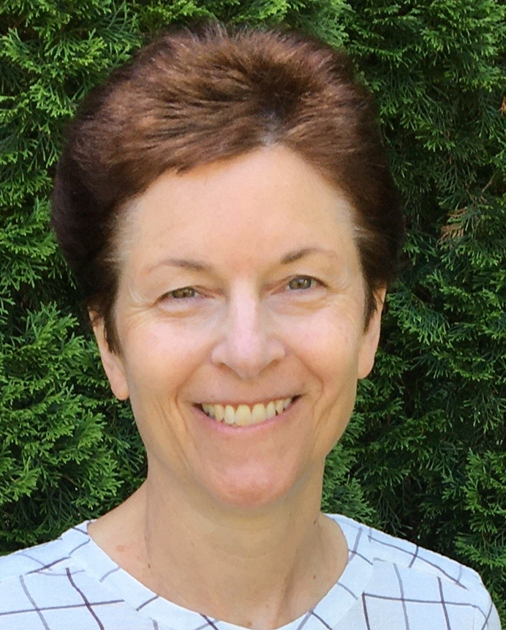

Office of the Dean, Provost and Executive Deputy Chancellor
Terence R. Flotte, MD
Dean, Provost and Executive Deputy Chancellor
Chief Research Officer
Cynthia Nicholson, FSA
Interim Chief of Staff
Regional
Executive Deans
- UMMS-Baystate
- UMMS Lahey
- Associate Dean for Veterans Affairs
Associate Deans, Educational Affiliates
Department
Chairs (28),
Directors of Centers, Programs and Institutes (12)
Stacy Potts, MD
Sr. Associate Dean for Graduate Medical Education and Clinical Affairs
Anne
Larkin, MD
Vice Provost for Educational Affairs
Katherine Luzuriaga, MD
Vice Provost for Clinical and Translational Science, Vice Provost for Research
Kate Fitzgerald, PhD
Vice Provost for Basic Science Research
Milagros
Rosal, PhD
Vice Provost for Health Equity
Mary Ahn, MD
Vice Provost for Faculty Affairs
Kate Lapane, PhD
Associate Dean of Population Health Sciences
Mary Ellen
Lane, PhD
Dean, Morningside Graduate School of Biomedical Sciences
Lisa Tison-Thomas, EdD
Assistant Dean, Career and Professional Development
Joan Vitello, PhD, RN
Dean, Tan Chingfen Graduate School of Nursing
Susan Feeney, DNP, FNP-C, FNP-BC, FAANP
Associate Dean for Advanced Practice Programs
Priscilla Gazarian, PhD
Associate Dean for Academic Affairs
Jill Terrien, PhD, ANP-BC
Associate Dean for Interprofessional & Community Partnerships
Teri Aronowitz, PhD, APRN, FNP-BC, FAAN
Associate Dean of Research and Innovation
Anne Garrison, MD
Associate Dean for Student Affairs
Manas Das, MD
Associate Dean for Undergraduate Medical Education
An Dinh, MD, MS
Senior Director of IREA
Tracy Kedian, MD
Associate Dean for Admissions and Pre-Matriculation Programs, SOM
Mary Piorun, PhD
Director of Library Services
Patricia Seymour, MD
Assistant Dean for Clinical Curriculum
Michael Ennis, MD
Assistant Dean for Student Affairs/Advising
Erin Turchetta, MA
Assistant Dean of Admissions
Mark Johnson, MD, PhD
Sr. Consulting Vice Provost for Mentorship, Leadership and Transformation
Brian Lewis, PhD
Assistant Vice Provost for Outreach and Recruitment
Robert Layne
Assistant Dean of Outreach Programs
Read Pukkila-Worley, PhD
Director, MD/PhD Program
Olufunmilayo Ayobami, PhD
Associate Dean Student Success and Engagement
Neal Silverman, PhD
Director, Umbrella Programs
Mary Munson, PhD
Associate Vice Provost for Equity in Science
Crista Johnson-Agbakwu, MD
Executive Director, Collaborative for Health Equity
Ricardo Poza, PhD
Assistant Dean for Curriculum Innovation
Mitchell Gitkind, MD
Assistant Dean of Health Systems Science
Emily Green, PhD
Associate Vice
Provost for Faculty
Development
Reports to Dean
Reports to Chief Research Officer
Reports to Provost
-
Alan Acosta, PhD
Associate Vice Provost for Student Life, and Director for Positive Learning Environ.
Melissa Fischer, MD, MEd
Associate Vice Provost for Interprofessional and
Instructional Innovation
Jennifer English
Director, Financial Aid
Michael Baker
Registrar
Michael Hirsh, MD
Assistant Vice Provost for Wellness and Health Promotion

