Slide 1
Statistics That Can Shape Disability Policy
Research by:

Slide 2
Acknowledgements The production of this webinar was funded by the National Institute on Disability, Independent Living, and Rehabilitation Research (NIDILRR), Grant #90DPEM0004. The content was funded by NIDILRR through grants funded to StatsRRTC, Grant #90RTGE0001. NIDILRR is a Center within the Administration for Community Living (ACL), Department of Health and Human Services (HHS). The contents of this presentation do not necessarily represent the policy of NIDILRR, ACL, or HHS and you should not assume endorsement by the Federal Government.
Notes:
NOTE: is this StatsRRTC logo acceptable?

Slide 3
What We Will Cover Today:
Statistics can help you shape disability policy.
The StatsRRTC is the go-to source for disability statistics.
Key statistics on employment for people with disabilities.
Examples of how disability statistics are used to drive policy.
Notes:
Our goals for the webinar today are for you to walk away with an understanding of the following points.

Slide 4
Statistics Can Help Shape Disability Policy
Policy makers need disability statistics to determine whether, or what, new policy approaches are needed.

Slide 5
StatsRRTC is the Go-to Source for Disability Statistics
Disability Statistics and Demographics Rehabilitation Research and Training Center (StatsRRTC) supports decision making through a variety of integrated and outreach activities, including the creation of the Disability Statistics Collection.
Notes:
The mission of the Rehabilitation Research and Training Center on Disability Statistics and Demographics (StatsRRTC) at the University of New Hampshire is to narrow and actively bridge the divide between the producers and end users of disability statistics, thereby supporting better data collection, more accurate information, better decision-making, more effective programs, and better lives for people with disabilities.

Slide 6
Activities Include
Improving knowledge about and access to existing statistics (and the underlying data)
Generating the knowledge needed to improve future disability data collection
Strengthening connections between the users of disability statistics, data collection agencies, and decision makers

Slide 7
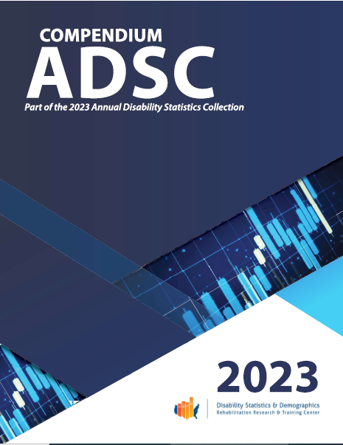
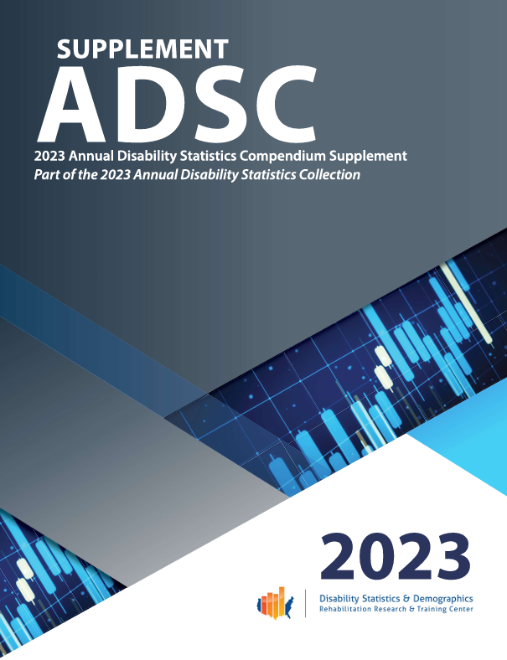
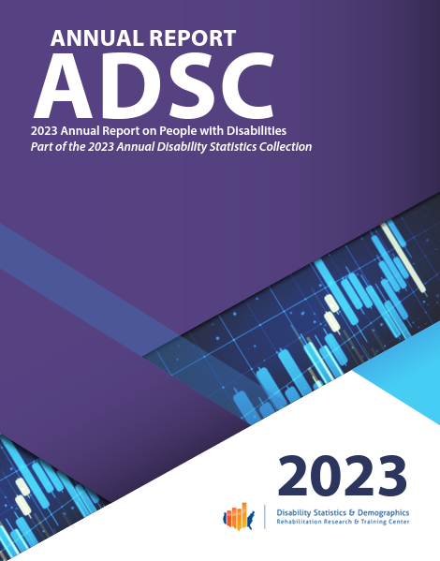
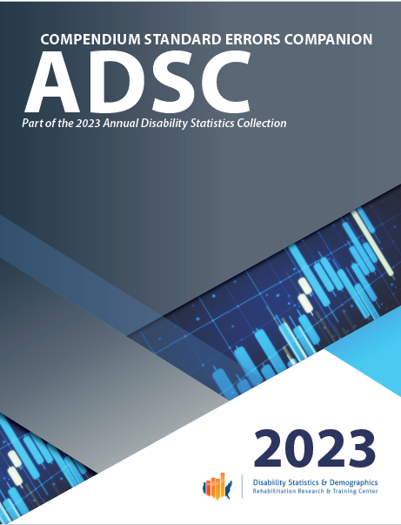
What the StatsRRTC Disability Statistics Collection Can Tell You

Slide 8
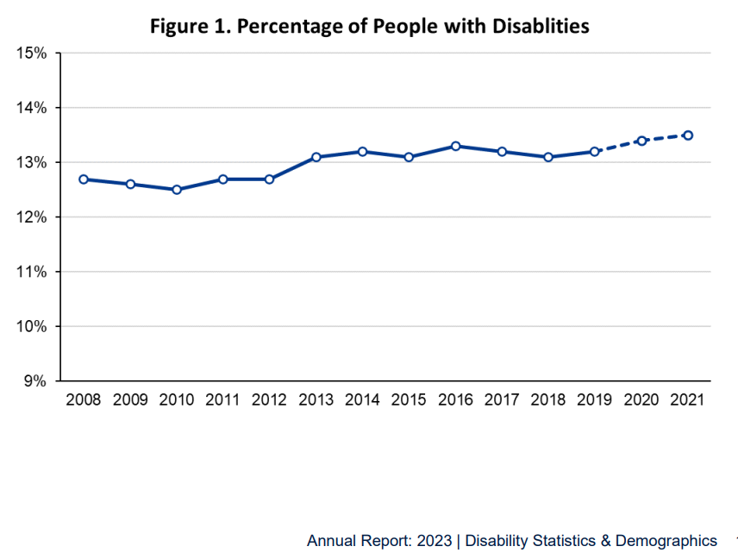
The Percent of US Population with Disabilities has Grown
Over time, disability prevalence is trending upwards.
In 2019, 13.2% (or 43,227,000) of all Americans
In 2021, 13.5% (or 44,482,000) of all Americans
Notes:
This information is from the StatsRRTC Annual Report.
NOTE: Chart on slide 10 shows this.

Slide 9
Employment Rate of People w/ Disabilities has Improved but Gaps Remain
The good news: The good news is that recent statistics (2008-2021) suggest that disability employ­ment rates reached a historic high (40.7% in 2021) perhaps indicating the success of the efforts to improve the employment of people with disabilities.
The bad news: Statistics collected between 2008-2021 suggest that the gap between the percentage of people with disabilities who were employed and those without typically hovered at 40%.
Notes:
Read this slide. Provide more details on the next slide with graph.
You will see a graph on our next slide but two key points to note are:
The good news is that recent statistics (2008-2021) suggest that disability employ­ment rates reached a historic high (40.7% in 2021) (Kessler Foundation & UNH Institute on Dis­ability, February 2022 nTIDE report) perhaps indi­cating the success of the numerous efforts to im­prove the employment of people with disabilities.
The bad news is that statistics collected between 2008-2021 suggest that the gap between the percentage of people with disabilities who were employed and those without typically hovered at 40%. While in 2021 there was slight reduction in the employment gap between people with and without disabilities, statistics suggest more needs to be done to narrow the employment gap between people with and without disabilities.

Slide 10
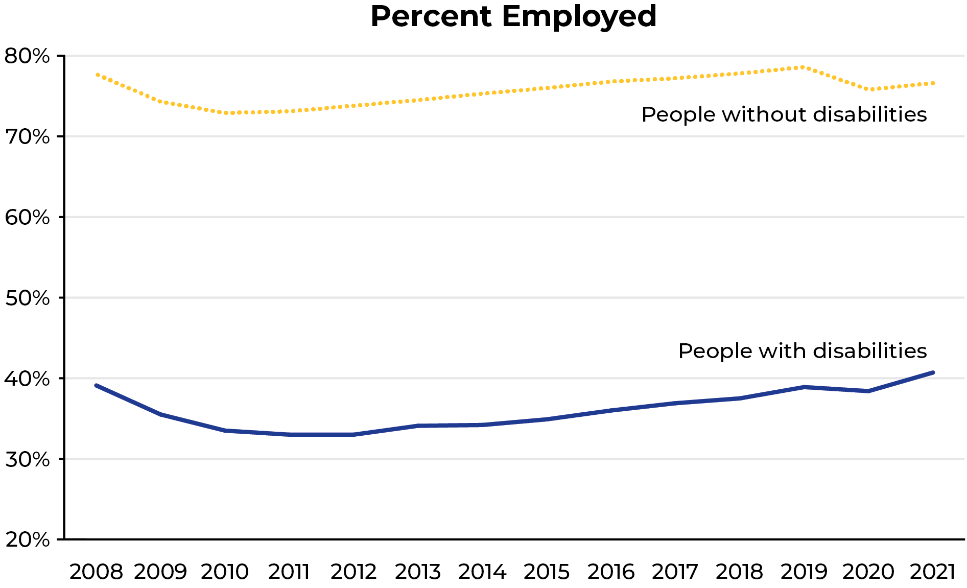
What can the Disability Statistics Collection Tell You?
Notes:
Provide these details here:
Overall, the percentage of people with disabilities that are employed (full or part-time) is nearly half of that of people w/out disabilities, i.e., 40.7% vs. 76.6% (a gap 35.9 percentage points).
However, recent statistics suggest that disability employment rates reached its highest historic levels since 2008 (Kessler Foundation & UNH Institute on Disability, February 2022 nTIDE report) perhaps indicating the success of the numerous efforts to improve the employment of people with disabilities. While in 2021 there was slight reduction in the employment gap (39.8 % 2019 to 35.9% in 2021) between people with and without disabilities, data from the past decade shows a worrisome trend. Since 2008 (38.6%) at points the gap between the percentage of people with disabilities who were employed and those without was as wide as 40.8%.

Slide 11
Earnings of People with Disabilities have Improved but Gaps have Widened.
The 2021 median earnings of full-time/ full-year workers with disabilities was $45,314. This is a $6,319 earnings gap when compared to people without disabilities.

Slide 12
People with disabilities are more than twice as likely to live in poverty.
In 2021, 25.4% of people with disabilities were in poverty compared to 11.8% of people without disabilities, which is a 13.6% gap.
Although poverty went down for both groups, the gap between people with and without disabilities still widened between 2010–2021.

Slide 13
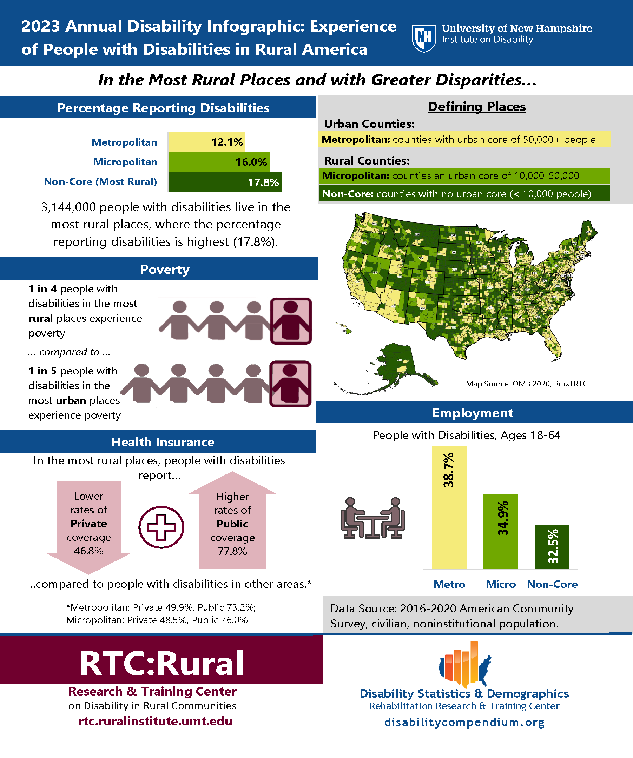
There are Rural Disparities
2023 Disability Statistics Infographic: Experience of People with Disabilities in Rural America
Over 3.1 million people with disabilities live in the most rural places.
They are more likely to live in poverty and to be unemployed compared to urban dwellers with disabilities.
Notes:
The StatsRRTC’s 2023 Disability Statistics Infographic: Experience of People with Disabilities in Rural America

Slide 14
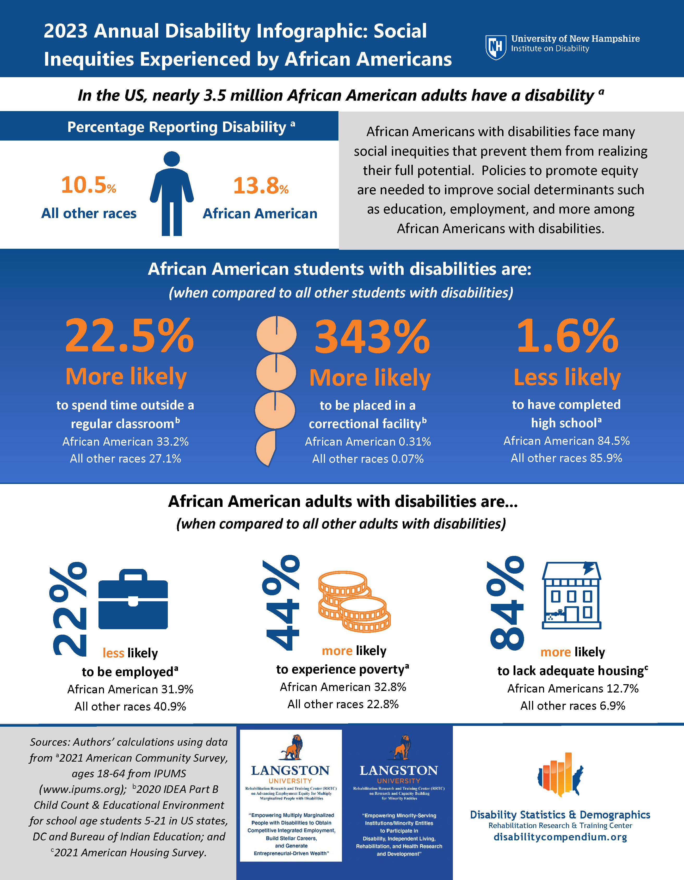
There are Racial Inequities
2023 Disability Statistics Infographic: Social Inequities Experienced by African Americans
In the U.S., almost 3.5 million Black and African American adults have a disability.
While the disability prevalence in all races was reported at 10.5%, for Black / African Americans it was 13.8%.
Black and African American adults with disabilities are 22% less likely to have a job compared to all races. Further they are 44% more likely to live in poverty than all races.
Notes:
The StatsRRTC’s 2023 Disability Statistics Infographic: Social Inequities Experienced by African Americans shows that in the U.S., almost 3.5 million Black and African American adults (ages 18–64) are considered to have a disability. While the disability prevalence in all races was reported at 10.5%, for Black/ African Americans it was 13.8%. Black and African American adults with disabilities are 22% less likely to have a job compared to all races. Further they are 44% more likely to live in poverty than all races.

Slide 15
Six questions are asked to define “disability” for the purpose of the American Community Survey (ACS).
Does the individual have difficulty in the following areas:
Notes:
The StatsRRTC’s Annual Reports on People with Disabilities in America are based on the six disability questions in the American Community Survey (ACS). A disability is defined as a “yes” to one of the disabilities identified by the questions. The questions are below:
1.Is this person deaf or does he/she have serious difficulty hearing?
2. Is this person blind or does he/she have serious difficulty seeing even when wearing glasses?
3. Because of a physical, mental, or emotional condition, does this person have serious difficulty concentrating, remembering, or making decisions?
4. Does this person have serious difficulty walking or climbing stairs?
5. Does this person have difficulty dressing or bathing?
6. Because of a physical, mental, or emotional condition, does this person have difficulty doing errands alone such as visiting a doctor’s office or shopping?

Slide 16
Examples of how StatsRRTC statistics have informed disability policy:
Disability statistics have been used to:
Create a formula for funding rural counties based on prevalence of disability.
Inform an audience of adult education and literacy field directors on the need for inclusive local programming.
Advocate for funding in a testimony to a state legislature.

Slide 17
About StatsRRTC
Policymakers have described the collection as ‘reliable, consistent, predictable,’ ‘essential,’ ‘the gold standard,’ and ‘a one stop shop.’ ”
Led by the University of New Hampshire, the StatsRRTC is a collaboration of the American Association of People with Disabilities (AUCD), Kessler Foundation, and Mathematica Policy Research.

Slide 18
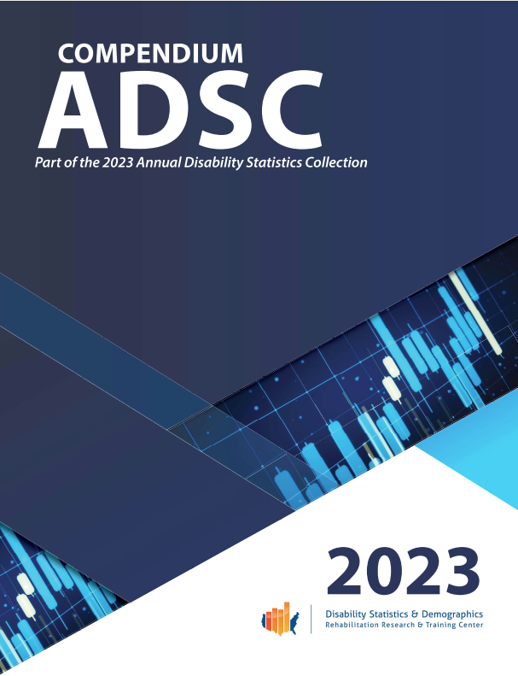
About the Disability Statistics Collection
The Disability Statistics Collection provides a singular location to obtain and compare the most recent federal, state, and county level disability statistics.
Policymakers can use the yearly and topic spanning disability statistics to advocate for and write legislation, view trends over time, compare their constituencies to others, and to inform stakeholders in their districts.

Slide 19
Conclusion
While employment rates have grown for people with disabilities, there is still a wide disparity.
Statistics play a key role in helping shape disability policy.
StatsRRTC is a NIDILRR funded center than is the go-to source for disability statistics.

Slide 20
Questions?

Slide 21
Thank you!

