Slide 1
Sharing Confidential and Sensitive Data
George Alter
Institute for Social Research
University of Michigan

Slide 2
About me
Research Professor Emeritus, Institute for Social Research, University of Michigan
Research specialty is historical demography and the history of the family
Recent work on data sharing and metadata standards
Former director of ICPSR, world’s largest social science data archive

Slide 3
Outline
Why is data sharing a big deal right now?
How do we share confidential data?
Data Repositories

Slide 4
Outline
Why is data sharing such a big issue?
  Skepticism of science
    Well-publicized cases of fraudulent data
    Publication bias
  Defending the legitimacy of science
  FAIR: Findable, Accessible, Interoperable, Reusable

Slide 5
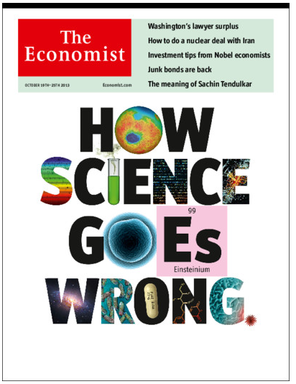
Skepticism of Science
Challenges to science
  Fraud and Mistakes
  Publication bias

Slide 6
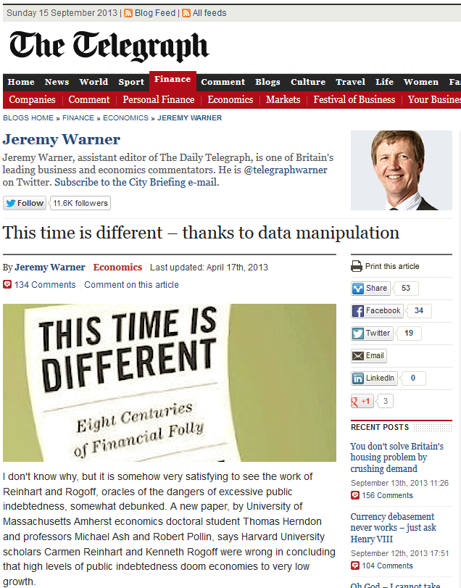
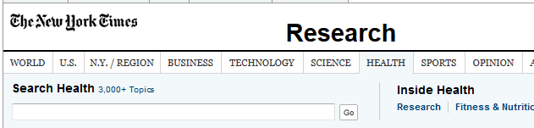
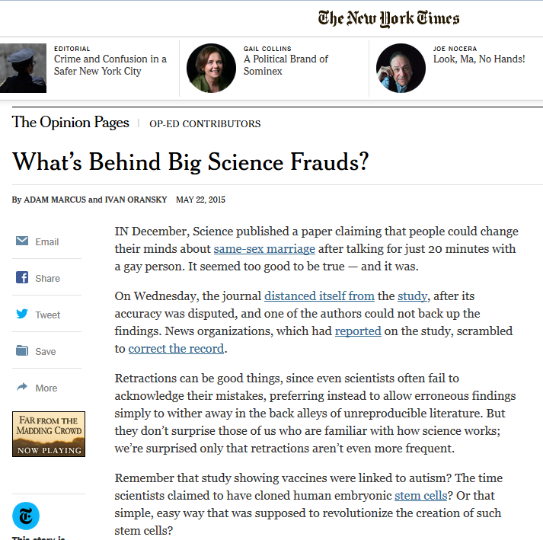
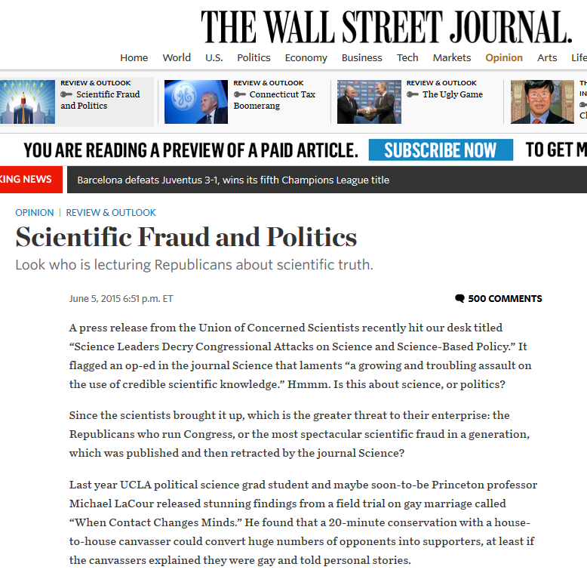
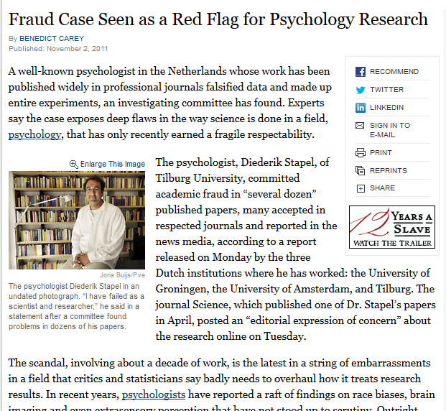
Skepticism of Science
Challenges to science
  Fraud and Mistakes
  Publication bias

Slide 7
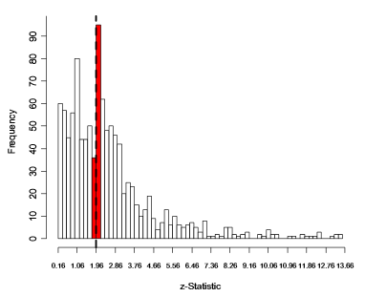
Publication Bias
Distribution of z-scores for coefficients reported in the APSR and the AJPS.
p-value = 0.05
Alan Gerber and Neil Malhotra, "Do Statistical Reporting Standards Affect What Is Published? Publication Bias in Two Leading Political Science Journals," Quarterly Journal of Political Science, 2008, 3: 313–326.

Slide 8
How do we defend the legitimacy of science?
What distinguishes the voice of science from every other voice on TV, radio, Internet, …?
Science has norms and ethics:
  Transparency
  Reproducibility
Who promotes these norms?
  Professional associations
  Funding agencies
  Journals

Slide 9
Data Access and Research Transparency
Professional associations are making data sharing an ethical standard
Data sharing is required by funding agencies
  NIH, NSF, Gates
Many journals require deposit of data and program code in a trusted repository

Slide 10

Research Transparency is Ethical Research
6. Researchers have an ethical obligation to facilitate the evaluation of their evidence based knowledge claims through data access, production transparency, and analytic transparency so that their work can be tested or replicated.
  6.1 Data access: Researchers making evidence-based knowledge claims should reference the data they used to make those claims. If these are data they themselves generated or collected, researchers should provide access to those data or explain why they cannot.
  6.2 Production transparency: Researchers providing access to data they themselves generated or collected, should offer a full account of the procedures used to collect or generate the data.
  6.3 Analytic Transparency: Researchers making evidence-based knowledge claims should provide a full account of how they draw their analytic conclusions from the data, i.e., clearly explicate the links connecting data to conclusions.

Slide 11
Findable, Accessible, Interoperable, Reusable (FAIR)
Requirements
Metadata following community standards
Persistent identifiers (e.g. DOIs)
Searchable Indexes (DataONE, bioCADDIE, Dataverse, Schema.org)
Data usage licenses
Data citation
Trusted Digital Repositories

Slide 12
Findable, Accessible, Interoperable, Reusable (FAIR)
FAIR is about making data accessible by machines
Persistent identifiers (PIDs)
  Allow machines to find:
    Data
    Definitions of variables
    Code lists
  URLs change frequently
  PIDs point to a registry with the current URL
Benefits:
  Suppose that you could write a short program that would harvest data from every country in the world into one merged data set

Slide 13
Outline
How do we share confidential data?
  Confidentiality and ethical research
  Why isn’t HIPAA enough?
  What are we afraid of?
  Five ‘Safes’
  Gradient of risk and harm
  Data use agreements
  Data repositories

Slide 14
Confidentiality and Ethical Research
What do we promise when we conduct research about people?
  That benefits (usually to society) outweigh risk of harm (usually to individual)
  That we will protect their privacy
Data sharing is an obligation to our subjects
  Subjects want the benefits that science can bring
  They want their data to be re-used

Slide 15
Why is confidentiality so important?
People may give us information that could harm them if revealed.
Examples: medical conditions, criminal activity, unpopular opinions, ...
Many subjects are wary about commercialization of their personal information

Slide 16

Why isn’t HIPAA enough?
HIPAA is not suited to complex data
  De-identification in HIPAA is focused on removing “direct” identifiers
    name, address, SSN, telephone number, etc.
  HIPAA did not anticipate:
    Deductive disclosure: Combination of multiple “indirect” identifiers
    Information that is easily available on the Internet
    Growth and accessibility of computing power
    DNA sequencing, facial recognition, machine learning, …
Notes:
Example – MET study of teachers
Teacher and student characteristics in 6 very large school districts
Can I identify teachers?
First step, identify schools
The data includes basic student characteristics: race, English language learners, subsidized lunch
To my surprise: NYC publishes a profile for every school with these characteristics
If you can identify the school: How may 6th grade English teachers are male and have been teaching for more 10 years?
In other words, it was easy to use the characteristics of students to identify their teachers.

Slide 17
Who are We Afraid of?
Parents trying to find out if their child had an abortion or uses drugs
Spouse seeking hidden income or infidelity in a divorce
Insurance companies seeking to eliminate risky individuals
Other criminals and nuisances
NSA, CIA, FBI, KGB, SABOT, SBL, SMERSH, KAOS, etc...

Slide 18
Deductive Disclosure
A combination of characteristics could allow an intruder to re-identify an individual in a survey “deductively,” even if direct identifiers are removed.
Dependent on
  Knowing someone in the survey
  Matching cases to a database

Slide 19
Protecting Confidential Data
A menu of measures that reinforce each other:
Safe data: Modify the data to reduce the risk of re-identification
Safe projects: Review research plans
Safe settings: Physical isolation and secure technologies
Safe people: Data use agreements and Training
Safe outputs: Results are reviewed before being released to researchers

Slide 20
Safe Data
Removing identifiers
Data masking
  Grouping values
  Top-coding
  Aggregating geographic areas
  Swapping values
  Suppressing unique cases
  Sampling within a larger data collection
  Adding “noise”
  Replacing real data with synthetic data
Notes:
Or, how do we Protect Waldo?

Slide 21
Safe Projects
Researchers submit a research plan
Research plan is reviewed for
  Feasibility: Can it be accomplished with these data?
  Consent: Is the research consistent with informed consent of subjects?
  Merit: Review by an independent, neutral panel of experts

Slide 22
Safe Settings
Data Protection Plans
  Data recipients must explain how they will protect against unauthorized use, theft, loss, hacking, etc.
Remote submission and execution
  User submits program code or scripts, which are executed in a controlled environment
Virtual data enclave
  Remote desktop technology prevents moving data to user’s local computer
Physical enclave
  Users must travel to the data

Slide 23
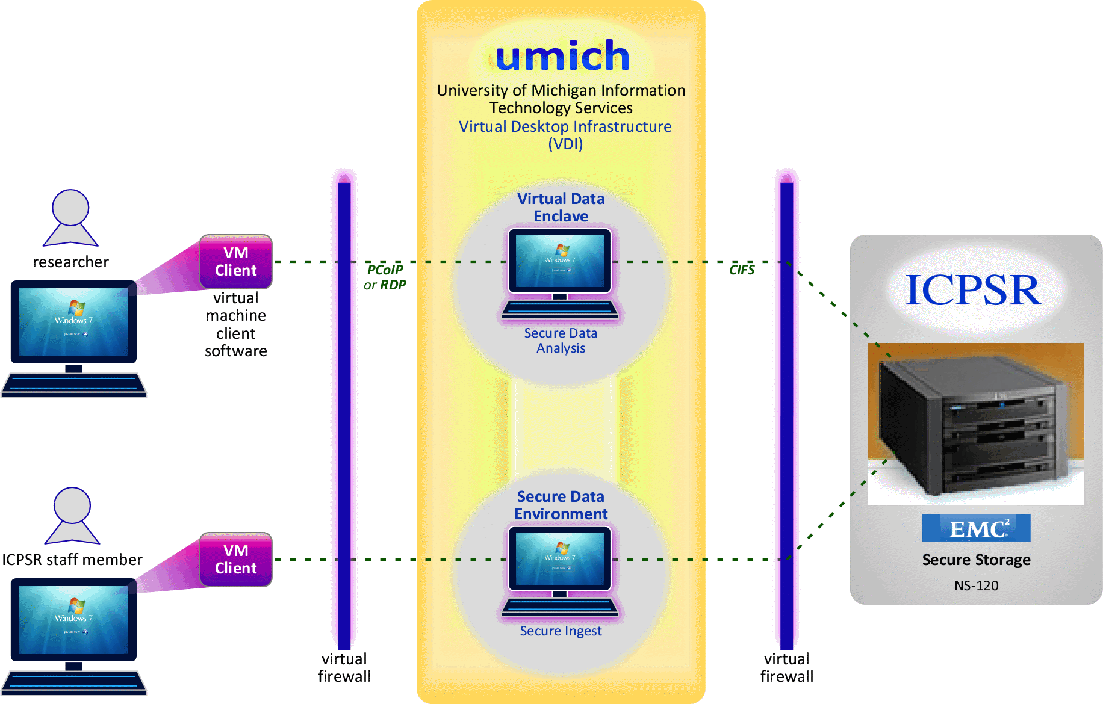
Virtual Data Enclave
Notes:
The visual.

Slide 24
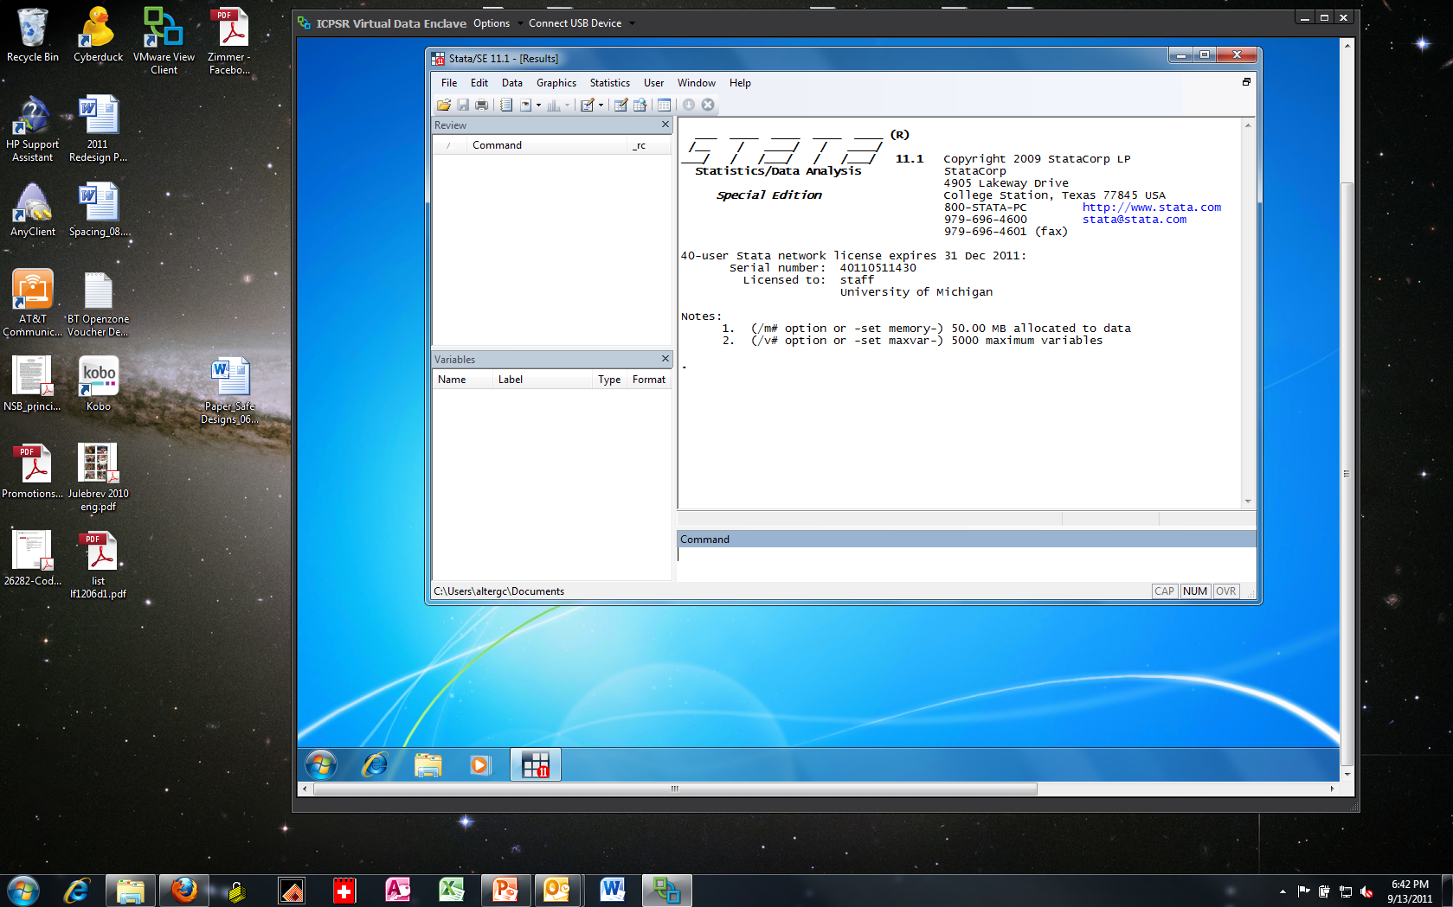
The Virtual Data Enclave (VDE) provides remote access to quantitative data in a secure environment.

Slide 25
Safe people
Data Use Agreements
  Parts of a data use agreement at ICPSR
    Research plan
    IRB approval
    Data protection plan
    Behavior rules
    Security pledge
    Institutional signature
Training in disclosure risks

Slide 26

Interview
Data archive
Data Use Agreement
Institution
Data Protection Plan
Informed Consent
Data Dissemination Agreement
Data flow
Research Plan
Data flow
Researcher
Data flow
IRB Approval
Data producer

Slide 27
Data Use Agreement: Behavior rules
To avoid inadvertent disclosure of persons, families, households, neighborhoods, schools or health services by using the following
guidelines in the release of statistics derived from the dataset.
  1. In no table should all cases in any row or column be found in a
  single cell.
  2. In no case should the total for a row or column of a cross-tabulation be fewer than ten.
  3. In no case should a quantity figure be based on fewer than ten cases.
  4. In no case should a quantity figure be published if one case
  contributes more than 60 percent of the amount.
  5. In no case should data on an identifiable case, or any of the kinds
  of data listed in preceding items 1-3, be derivable through subtraction
  or other calculation from the combination of tables released.

Slide 28
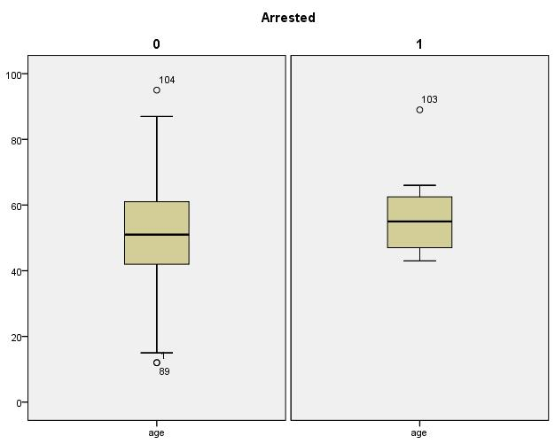
Safe People: Disclosure risk online tutorial
Disclosure: Graph with extreme values example
Data were collected for a sample of 104 people in a county.
Among the variables collected were age, gender, and whether the person was arrested within the last year. Box plots below show the distribution of age, one plot for those arrested and one for those who were not. The number labels are case number in the dataset.
The potential identifiability represented by outlying values is compounded here by an unusual combination that could probably be identified using public records for a county in the U.S. --someone approximately 90 years old was arrested in the sample. Including extreme values is a disclosure risk for identifiability when combined with other variables in the dataset.
Arrested in last year?
yes
no
N | 104
min age | 12
max age | 95
mean age | 51
std dev | 15
% female | 5.2
% arrested | 5.8

Slide 29
Safe outputs
Controlled environments allow review of outputs
  Remote execution systems, Virtual data enclaves, Physical enclaves
Disclosure checks may be automated, but manual review is usually necessary

Slide 30
Balancing Costs and Benefits
Data protection has costs
  Modifying data affects analysis
  Access restrictions impose burdens on researchers
Protection measures should be proportional to risks
Two dimensions of risk
  Probability that an individual can be re-identified
  Severity of harm resulting from re-identification

Slide 31
Gradient of Risk & Restriction
High severity of harm & highly identifiable
High Risk Enclosed Data Center
Severity of Harm
Moderate Risk
- Strong DUA & Technology Rules
Complex data: moderate harm & re-identifiable with difficulty
Complex Data: low harm & low probability of disclosure
Some Risk Data Use Agreement
Simple Data: minimal harm & very low chance of disclosure
Tiny Risk
Web Access
Probability of Disclosure

Slide 32
3. Data Repositories
What should we expect from data repositories?
Certification of trusted digital repositories
Examples:
  Vivli
  dbGaP
  ICPSR
Data citation

Slide 33
What should we expect from data repositories?
Scientific data should be
Discoverable – Searchable catalog
Meaningful – Curated and documented
Usable – Accessible in non-proprietary formats
Citable – Citations with persistent identifiers
Trustworthy – Transparent procedures
Persistent – Sustainable organizations

Slide 34

Trusted Digital Repositories are certified
16 guidelines
Self-assessment with peer review
70+ certified
Archaeology, environmental science, geoscience, oceanography, seismology, social sciences, space science, traumatic brain injury research, …
ISO 16363
Based on Trustworthy Repositories Audit & Certification: Criteria and Checklist (TRAC)
100+ criteria

Slide 35

Data sharing and analytics platform for clinical trials
Non-profit that brings together data from both academic and private industry
  Members include AstraZeneca, Bayer, Biogen, Johnson & Johnson, Lilly, Pfizer
Studies available from members are listed in the Vivli catalog
Remote access and analysis model
  Data remain on secure servers at Vivli
Access procedure
  Data contributor checks feasibility of request
  Independent Review Panel evaluates merits of research proposal
  Data Use Agreement between Vivli and researcher’s university

Slide 36

Genomic data
NIH funded researchers are required to deposit genomic data in dbGaP
Access to dbGAP data
  Access is approved for a specific project
  Reviewed by an NIH Data Access Committee
  Institution must sign Data Use Certification
dbGaP data often come with limitations
  Research may be limited by disease, methodology, geography, etc.
    “… Study data may not be used to investigate individual participant genotypes, individual pedigree structures, perceptions of racial/ethnic identity, non-maternity/paternity, and of variables that could be considered as stigmatizing an individual or group.”

Slide 37
ICPSR has biomedical data too!
Spinal Cord Injury Rehabilitation Study, United States, 2007-2010 (ICPSR 36724)
National Longitudinal Study of Adolescent to Adult Health (Add Health), 1994-2018 (ICPSR 21600)
Population Assessment of Tobacco and Health (PATH) Study (ICPSR 36498)
Collaborative Psychiatric Epidemiology Surveys (CPES), 2001-2003 [United States] (ICPSR 20240)
National Comorbidity Survey: Reinterview (NCS-2), 2001-2002 (ICPSR 35067)
National Health and Nutrition Examination Survey (NHANES), 2007-2008 (ICPSR 25505)
National Study of Physician Organizations (NSPO3), United States, 2012-2013 (ICPSR 38587)

Slide 39
Thank you
George Alter
altergc@umich.edu

