Slide 1


Suicide Prevention Implementation Across Diverse Healthcare Settings Using the ECHO Model
Lessons from the American Foundation for Suicide Prevention and the
American Academy of Pediatrics
Corbin J. Standley, PhD; Senior Director of Impact Communication and Continuous Improvement, AFSP
Kristen Kaseeska, MPH; Manager of Suicide Prevention, AAP
Jessica Leffelman, BS; Manager of ECHO Initiatives, AAP

Slide 2


Blueprint for Youth Suicide Prevention
Educational resource designed for clinicians, public health professionals, educators, advocates
Strategies to support youth via:
  Clinical pathways
  Community partnerships
  Policy and advocacy
Co-authored by AAP and AFSP, in collaboration with experts from NIMH
Endorsed by 19 medical/public health organizations
Gorzkowski et al. (2022)

Slide 3

Summit & Focus Meetings
Convened in Spring and Summer 2021
Convened cross-sectoral partners and experts
Discuss context surrounding suicide among youth, as well as the landscape around science, practice, programs, and policy
Identify concrete clinical, community, and advocacy strategies
Focused on health equity and lived experience
Gorzkowski et al. (2022)

Slide 4
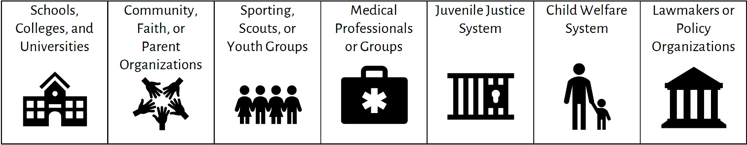
Summit & Focus Meetings Takeaways
Suicide can often be prevented
Health equity is critical to suicide prevention
Strategies to improve suicide prevention include both resources and education
Cross-sectoral partnerships are essential
Calabrese et al. (2024); Gorzkowski et al. (2022)

Slide 5
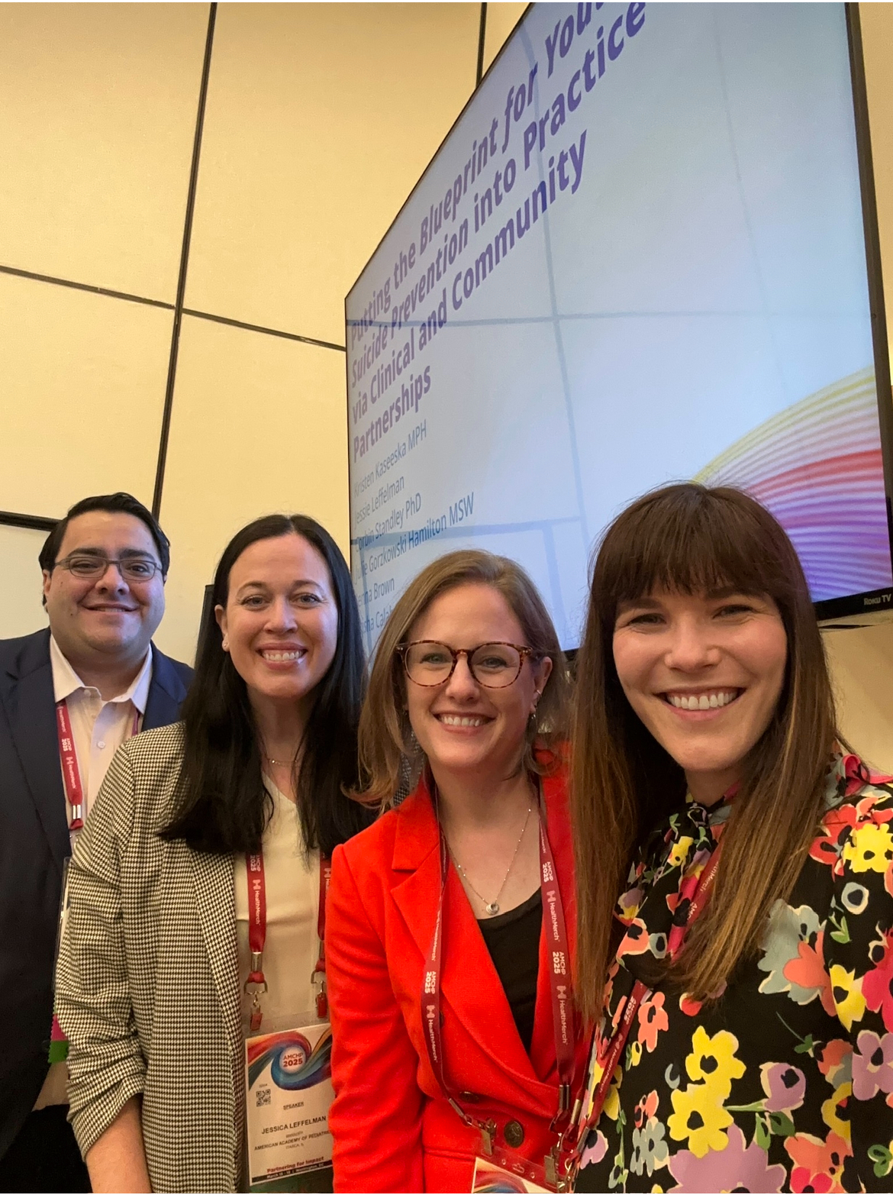
AFSP & AAP Partnership
The AAP-AFSP partnership continued through 2025 to operationalize the Blueprint through a series of Project ECHO initiatives focused on healthcare settings, schools, and communities.
  Leverage national reach and chapter networks
  Complementary subject matter expertise in pediatric health, suicide prevention
  Shared focus on clinical care, community efforts, policy change
  Shared goal to reduce rates of suicide in youth and young adults

Slide 6





AAP as a Superhub
Dedicated to the Health of all Children
In 2013, the American Academy of Pediatrics (AAP) became an ECHO hub and two years later in 2015, the AAP was invited to serve as the pediatric training and replication arm of ECHO, becoming a pediatric Superhub. The AAP links pediatric experts with pediatric healthcare providers helping them develop the necessary skills to provide their patients with the right care, at the right place, at the right time.
ECHO Programming
Technical Assistance
67,000 members
66 state and local chapters
23 national committees,
52 sections, 13 councils
480 staff; Offices in Illinois; Washington DC
Hub Training
Collaboratives

Slide 7
Impact
Initiatives
40 Topics
140 Programs
Reach
130+ Cohorts
50 US states
Training
104+ Hubs Trained
27 AAP Chapters
1,371 Sessions
3,900 Organization Interactions
120+ Hub Trainings and TA Support
130+ Cohorts
3,900+ Organization Interactions
50 US States

Slide 8


Snapshot:2023- 2025
PARTICIPANT ROLES
Participants report a high return on investment (ROI) of time and effort, indicating that the program’s content is both valuable and directly applicable to their professional practice.
0
5.9
7
Advanced Practice Providers
(153)
(Low ROI)
(High ROI)
Allied & Specialized Health
(72)
PARTICIPANT SATISFACTION
Nurses
(269)
Specific practice & process changes participants planned to adopt as a result of participating in an ECHO
Physicians
(1,272)
Patient Communication & Counseling
Parents & Caregivers
(46)
Screening & Assessment
Patient Education
Telehealth & Technology
Non-Clinical
(33)
Practice & Workflow Improvements
Community Engagement
Policy Changes
PRACTICE & PROCESS CHANGES
Education & Research
(62)
78%
Of participants* (n=462 out of 595 from 50 programs) planned to modify what they do in practice.
Public Health & Policy
(112)
Mental Health & Social Services
(222)
77%
Of participants* (n=457 out of 597 from 50 programs) intended to implement new strategies in practice.
96%
Of participants* (n=553 out of 577 from 50 programs) identified specific practice & process changes they plan to adopt.
*Participants who completed the post program CME Attestation Survey
PARTICIPANT CHANGES

Slide 9
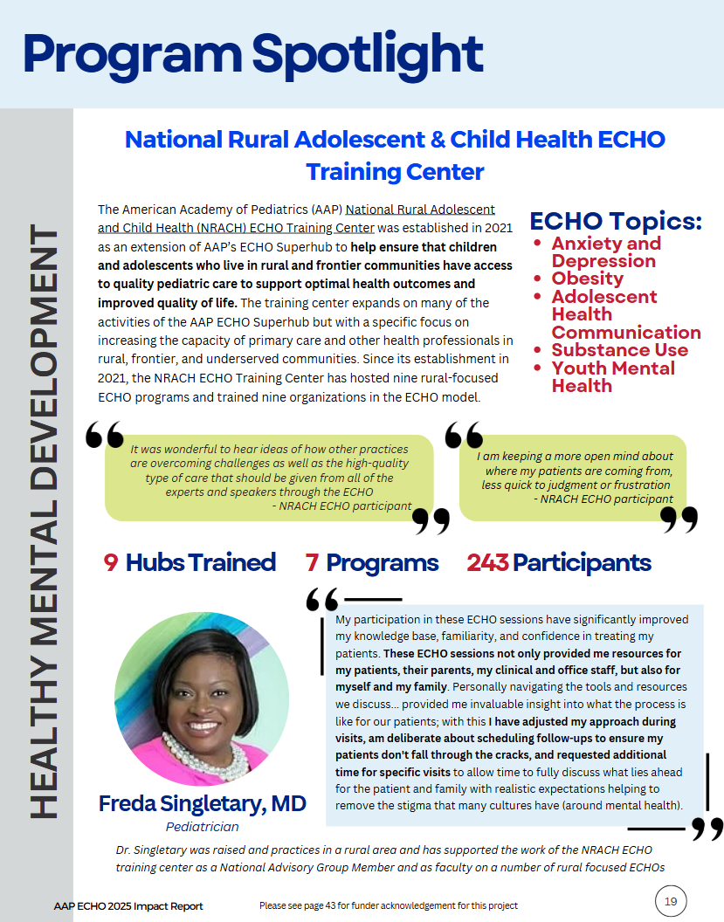
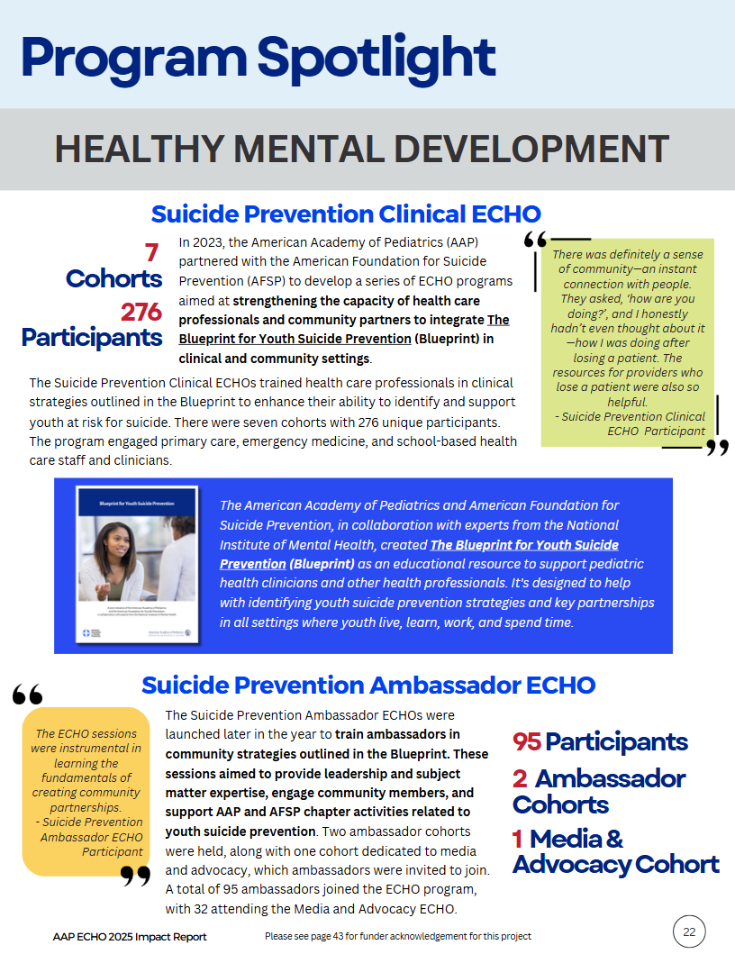
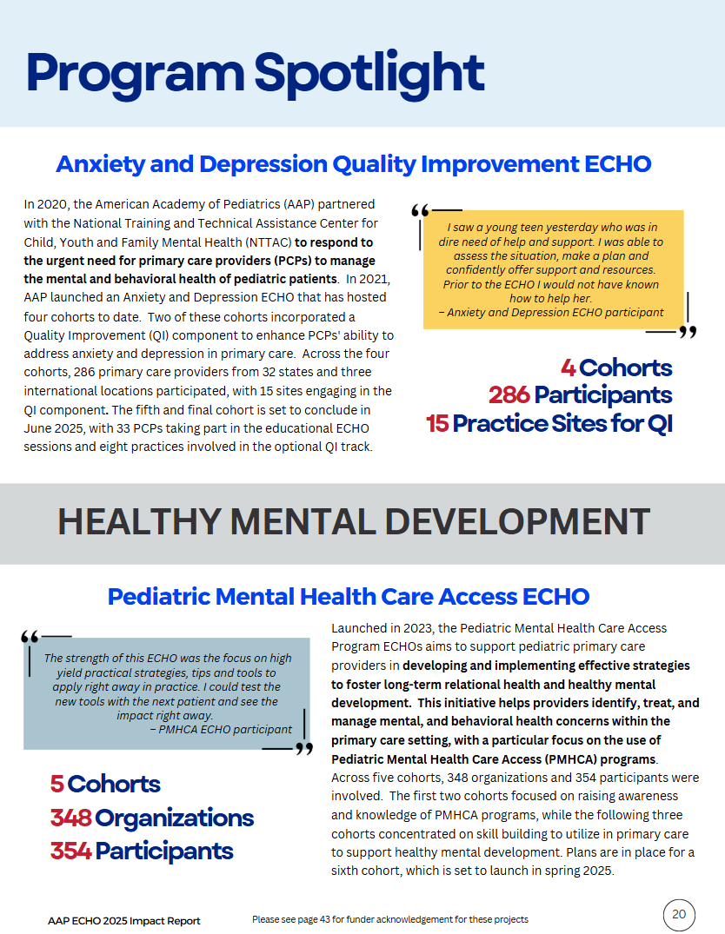
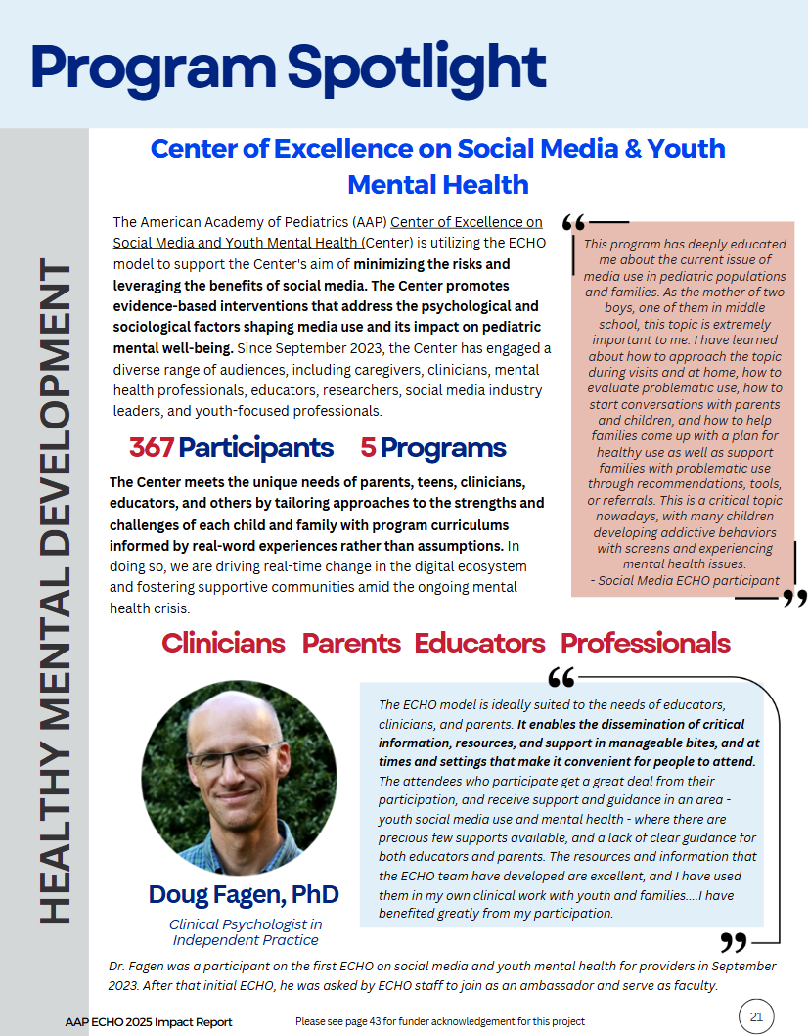
Healthy Mental Development

Slide 10
AFSP/AAP Grant Overview
AFSP and AAP partnered to develop a series of ECHO programs that build the capacity of health care professionals and community partners to integrate the Blueprint for Youth Suicide Prevention in clinical and community settings.
Clinical ECHOs
Ambassador ECHOs
Engage community pediatricians and healthcare professionals in quality improvement project.
Build knowledge and self efficacy on best practices for suicide prevention care
Gain peer support and sense of community
Demonstrate practice change related to clinical outcomes.
Primary Care, Emergency Medicine, and School-Based Health cohorts
Engage ambassadors to establish clinical-community partnerships for community change.
Build knowledge and self efficacy on best practices for community prevention
Gain peer support and sense of community
Identify opportunities to increase suicide prevention education and influence state-level change.
Partner AAP and AFSP Chapters

Slide 11
Suicide Prevention ECHO Timelines
Grant start date: July 1, 2022
Grant end date: June 30, 2025
ECHO Cohort | Audience | Start\ | Finish
Clinical ECHO Cohort 1 | Primary Care | Jan-23 | Aug-23
Ambassador ECHO Cohort 1 | AAP and AFSP Ambassadors | Jan-23 | Aug-23
Clinical ECHO Cohort 2 | Primary Care with QI | Jul-23 | Feb-24
Clinical ECHO Cohort 3 | School Based Health Care Clinicians | Oct-23 | Mar-24
Ambassador ECHO Cohort 2 | AAP and AFSP Ambassadors | Jan-24 | Aug-24
Clinical ECHO Cohort 5 | Primary Care with QI | Feb-24 | Sep-24
Clinical ECHO Cohort 4 | Emergency Medicine | Mar-24 | Aug-24
Clinical ECHO Cohort 6 | Primary Care with QI | Jul-24 | Feb-25
Ambassador ECHO Cohort 3 - Level 2 | AAP and AFSP Ambassadors | Aug-24 | Oct-25
Clinical ECHO Cohort 7 | School Based Health Care Clinicians | Sep-24 | Feb-25
Clinical ECHO Cohort 8 | Primary Care with QI | Sep-24 | Apr-25

Slide 12
Clinical Suicide Prevention ECHO Goals and Outcomes
Health care professionals were trained in clinical strategies described in the Blueprint for Youth Suicide Prevention to increase capacity regarding practices to identify and support youth at risk for suicide.
Expected Outcomes:
Participants will build knowledge and self-efficacy on best practices related to the integration of suicide prevention care pathways into clinical practice, in order to improve the quality of care delivered to patients.
Participants will gain peer support and a sense of community.
Practices will demonstrate practice change related to identified clinical quality measures.

Slide 13
Educational ECHO Session
Clinical ECHO
1 hour
  Introductions/Housekeeping (5 min)
  Lecture (20 min)
  Lecture Q&A (5 min)
  Case presentation and/or facilitated discussion (25 min)
  Wrap-up and evaluation (5 min)

Slide 14
Engaging Subject Matter Experts (SMEs)
We aimed to recruit faculty who represent diversity across:
  Professional roles and disciplines
  Practice settings and geographic regions
  Lived experiences and cultural perspectives
  Career stages and areas of specialty
All teach, all learn philosophy
Recruitment of SMEs included reaching out to:
  Authors of the Blueprint for Youth Suicide Prevention
  SMEs from previous AAP programs/projects with experience with this topic
  AAP Committee, Counsel, or Section leaders
  Engaged ECHO participants
Notes:
Our goal is to build a faculty team that strengthens learning through representation, inclusion, and shared expertise.
As part of our commitment to creating an inclusive and impactful learning environment, we are prioritizing the identification of diverse faculty voices to support this program.
Bringing together faculty with a variety of backgrounds, experiences, and perspectives helps to:
Enrich discussions and learning opportunities
Reflect the communities and participants we serve
Promote equity in professional education and leadership
Ensure a broad range of real-world approaches and expertise

Slide 15
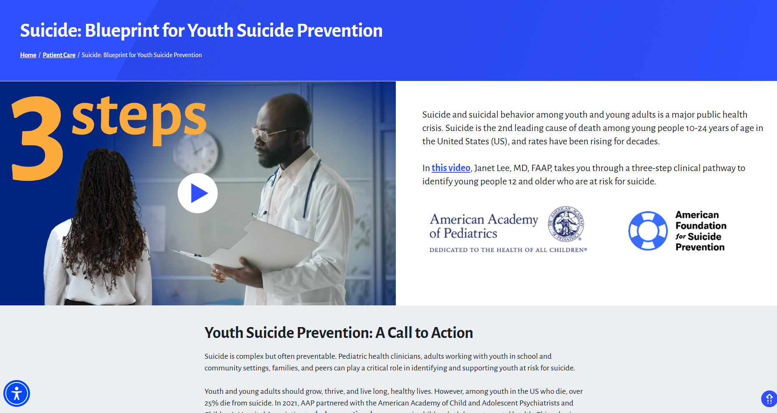
Curriculum Development
Defined the program overarching goals and objectives
Identified the major content areas and separate into 8 sessions
  Adapted from the Blueprint for Youth Suicide Prevention
Developed individual session learning objectives
  Ensured the learning objectives were actionable and measurable
Built session content and activities
  Materials included slide decks for the lectures, case forms, group discussions, polls, Putting Evidence into Practice (PEiP), and resources
Identified the faculty presenter(s)/facilitator(s)

Slide 16
Participant Recruitment
Goal: up to 30 participants per cohort
  Included teams from same practice/organization
Target Audience: primary care physicians and other clinicians that work in primary care setting
Recruitment Materials: Created program flyer, email and website templates, registration, FAQs sheets, and videos
Strategies:
  Dissemination through AAP committee, council and section listservs
  Previous ECHO program listservs
  Information included in newsletters and messaging to AAP leadership and groups
  Engaged faculty and previous ECHO participants to promote
  Partnering with organizations that have aligned goals
Notes:
Stronger interaction and increased engagement
With fewer attendees, participants are more likely to speak up, ask questions, and contribute to discussion. Larger webinars can become passive with multiple people off camera and multi-tasking. When attendance is small, participants are more likely to stay attentive and engaged.
More relevant learning experience
Facilitators can create the sessions to be more focused by using relevant examples to the specific group and participants also have more opportunities to clarify concepts in real time.
More personal connection and community building
ECHO is a relationship-building telementoring model. Smaller attendance allows people to recognize one another, build rapport, and feel part of a cohort rather than an anonymous audience.
Creation of a safe space
Participants may feel more comfortable sharing ideas, challenges, or sensitive questions in a smaller setting than in front of hundreds of people.
Higher quality Q&A
In large programs, many questions can go unanswered. Small groups allow time to address questions thoroughly and make the session feel more responsive.

Slide 17
Suicide Prevention Clinical ECHO Program
Over the course of the project, 276 individuals (61% pediatrician, 74% white) representing 205 practices (66% primary care, 55% suburban) participated in the educational ECHO program.

Slide 18
Suicide Prevention ECHO Timelines (cont.)
Grant start date: July 1, 2022
Grant end date: June 30, 2025
ECHO Cohort | Audience | Start | Finish
Clinical ECHO Cohort 1 | Primary Care | Jan-23 | Aug-23
Ambassador ECHO Cohort 1 | AAP and AFSP Ambassadors | Jan-23 | Aug-23
Clinical ECHO Cohort 2 | Primary Care with QI | Jul-23 | Feb-24
Clinical ECHO Cohort 3 | School Based Health Care Clinicians | Oct-23 | Mar-24
Ambassador ECHO Cohort 2 | AAP and AFSP Ambassadors | Jan-24 | Aug-24
Clinical ECHO Cohort 5 | Primary Care with QI | Feb-24 | Sep-24
Clinical ECHO Cohort 4 | Emergency Medicine | Mar-24 | Aug-24
Clinical ECHO Cohort 6 | Primary Care with QI | Jul-24 | Feb-25
Ambassador ECHO Cohort 3 - Level 2 | AAP and AFSP Ambassadors | Aug-24 | Oct-25
Clinical ECHO Cohort 7 | School Based Health Care Clinicians | Sep-24 | Feb-25
Clinical ECHO Cohort 8 | Primary Care with QI | Sep-24 | Apr-25
Notes:
After the first 2 primary care clinical cohorts we knew we had to redesign our sessions
Participants shared that while the sessions provided valuable knowledge, they wanted more actionable, practical steps they could apply immediately in their day-to-day work

Slide 19
Putting Evidence into Practice (PEiP)
Based on participant feedback, we revamped the program to include a dedicated Putting Evidence Into Practice component
Participants in the early cohorts shared that while the sessions provided valuable knowledge, they wanted more actionable, practical steps they could apply immediately in their day-to-day work
This portion of each session is designed to help participants:
  Translate key evidence into real-world practice
  Identify concrete strategies they can implement immediately
  Leave each call with at least one new tool or approach to try that same day

Slide 20
What Does an Educational ECHO Session Look Like?
Clinical ECHO
1 hour
Clinical ECHO
1.25 hours
  Introductions/Housekeeping (5 min)
  Lecture (20 min)
  Lecture Q&A (5 min)
  Case presentation and/or facilitated discussion (25 min)
  Wrap-up and evaluation (5 min)
  Introductions/Housekeeping (5 min)
  Lecture (20 min)
  Lecture Q&A (10 min)
  Putting evidence into practice & discussion (30 min)
  Wrap-up and evaluation (5 min)
Notes:
Needed

Slide 21
PEiP Examples
Featured an interview with a past ECHO participant who successfully implemented a suicide prevention protocol within her practice
  She shared practical strategies for gaining leadership and staff buy-in and the participants had the opportunity to ask questions
Small-group discussions in breakout rooms where clinicians identified where they were in the protocol implementation process and then learned from subject matter experts and their peers some action items to move to the next step
Group discussion about self-care planning and reflection, as many clinicians had indicated some level of feeling burnt out
  Discussed strategies to support clinician well-being throughout practice change and shared tools and resources

Slide 22
Quality Improvement
The QI aim for this program was for pediatric primary care practice teams to improve universal screening and follow-up practices for suicidal ideation and behavior among patients aged 12-21 years.
Teams used QI methodology to develop and implement effective strategies that increase compliance with standard of care guidelines, including performing and following up on suicide screening with assessment, referral to mental health evaluation or outpatient mental health treatment, safety planning, lethal means safety counseling, connecting families with additional resources, and discussing suicide risk with patients and their families.

Slide 23
Benefits of Participation
Measure progress across the program
Improve the quality of care for your youth patients
Expand skills and confidence following best practices related to youth suicide prevention
Engage with others in similar roles across the country
Utilize support from an expert QI Coach
Develop effective processes and workflows that are specific to your practice
Gain opportunities to earn professional credit (25 MOC part 4)

Slide 24
Quality Improvement Requirements
Establish a core QI team
  Meet at least monthly with core QI team
Collect and submit data for 7 monthly cycles
Representative participates in all ECHO learning sessions
Participate in PDSA cycles and data reviews with QI Coach
Complete all project surveys

Slide 25
Measures
Measure | Definition
Administer universal suicide screening | % of patients 12-21 years old who have had an age-appropriate practice-standardized suicide screening administered at the most recent health supervision consistent with AAP recommendations.
Conduct brief suicide safety assessment | % of patients ages 12-21 with a positive suicide risk screen for whom a brief suicide safety assessment was conducted during a recent health supervision visit.
Refer for mental health evaluation | % of patients ages 12-21 with a positive risk screen for suicide and a non-acute positive suicide safety assessment for whom a referral for further mental health evaluation was made during a recent health supervision visit.
Balancing Measure | Impact of intervention on practice's clinical work, measured by time
Notes:
Changed from 7 measures

Slide 26
Quality Improvement Aims
4 Practices
QI Aim: Implement the youth suicide blueprint and follow those guidelines. The doctor reported that joining the ECHO allowed her and her team to implement a suicide screening and assessment through incremental change over a period of eight months. In addition, her CMO set a goal of testing implementation with one care team that could then inform protocols and training that would be needed as they implement suicide prevention blueprint across all providers and their teams
QI Aim: Design and train providers on a suicide prevention protocol in the fall of 2024. Develop the underlying infrastructure, including EMR and coding to enable ‘go live’ in the fall timeframe.
QI Aim: Build systems, communication strategies, and infrastructure to implement a suicide prevention protocol based on clinical strategies described in the Blueprint.
QI Aim: Build reliable systems, communication strategies, and infrastructure to implement a suicide prevention protocol in a specific location.

Slide 27
Post-Project: Primary Care
Those participants who engaged in the monthly ECHO sessions were more likely to drive practice change and implement suicide prevention protocols into their health care systems.
Post-Project Survey: Primary Care (n=21)
Data indicate increased participant capacity for practice change related to suicide risk screening and assessment.
Emergent themes from key informant interviews and meeting notes show attrition in participation due to physician burnout, capacity to continue a new project, and professional and personal conflicts during the meeting times.
Out of all respondents who completed the survey (n=21), 95% (n=20) reported increases in knowledge and confidence in implementing suicide prevention protocols within their practice. Areas that recorded the most increase were the identification of validated suicide risk screening tools, brief interventions to care for youth who are not at risk for imminent risk for suicide, and strategies to identify mental health resources in their community.

Slide 28
Post-Project: Primary Care (cont.)
Of those who responded, 81% (n=17) indicated a desire to change their practice flow because of participation in this program.
Select verbatim responses to the types of practice changes that would be implemented included:
“Suicide risk screening and assessment.”
“We are going to work with our IT to integrate screening into our EHR.”
“Will create and implement better protocols for those children that screen nonacute positive and will be sure we have follow up protocols in place for all that screen positive.”
“My team and I have already started the discussion around roles and responsibilities for suicide prevention protocol within our practice. We will continue these conversations and create protocols to keep this work moving forward.
“Creating a resource to keep within the exam rooms for physicians and personnel. Will include scripts, lethal means counseling, outside resources, etc.”
“We are partnering with EHR to update and include suicide risk screening as well as follow up reminders for patients who screen positive.”

Slide 29
Tailoring the Program for Different Audiences
Additional health care settings were identified that would benefit from the content, including emergency medicine and school-based healthcare settings
Project staff identified subject matter experts within these specialties to serve as program faculty
Revised the curriculum to ensure content was relevant and tailored to each audience
Expanded recruitment efforts to engage participants from these practice areas
Launched 2 cohorts of the school-based health care content and one cohort of the emergency medicine content

Slide 30
Suicide Prevention ECHO Program:
Emergency Medicine Cohort
Participants: Number of ECHO Attendees: 69 health care professionals
ECHO Participation and Post Survey Data: Post-session survey was shared after each session.
Overall, participants reported that the curriculum content and subsequent discussions were useful and relevant to their work and indicated confidence in applying the skills learned to their practice.
Post program feedback:
The information in the program was useful and relevant to my work: 97% (n=32)
I have confidence in my ability to apply skills learned from the program in my work: 91% (n=32)
Qualitative feedback from the participants from surveys, ECHO Zoom chat box, and emails:
I wasn't aware of the statistics...staggering.
Opening my eyes to the problem of Adolescent suicide!
The thing I liked best about this is the discussion with the experts
Very informative, love the format and discussion
I appreciated being able to discuss the challenges and some solutions, as well as have a list of resources shared
It’s good to understand what others are doing. I don’t work in just a Pediatric ED so it’s helpful to understand especially based on resources.
I like the discussion about local and national resources available
I wish there was more time because the information shared is so important and helpful

Slide 31
Suicide Prevention ECHO Program:
Emergency Medicine Cohort (cont.)
Topic
Addressing Suicide Prevention in Emergency Department Settings
Screening for Youth Suicide Risk in Emergency Department Settings
Conducting a Brief Suicide Safety Assessment (BSSA)
Providing Appropriate Care​ in the Emergency Department Setting ​ for Youth at Risk ​for Suicide​
Planning a Safe Discharge from the Emergency Department
Preparing Your Emergency Department Setting for a Suicide Prevention Protocol

Slide 32
Suicide Prevention ECHO Program:
School Based Health Care Cohorts
Participants: Number of ECHO Attendees: 65 health care and school-based professionals
ECHO Participation and Post Survey Data: Post-session survey was shared after each session.
Overall, participants reported that the curriculum content and subsequent discussions were useful and relevant to their work (96%, n=71) and indicated confidence in applying the skills learned to their practice (92%, n= 66).
Post program feedback: All of the participants (15/15) that responded to the survey self-reported increases in knowledge and confidence in implementing suicide prevention protocols within their institutions. Areas that recorded the most increase were how to demonstrate ways to meaningfully communicate intervention strategies with students and families, how to describe the distinct roles that school-based health center teams and school teams have in suicide prevention strategies, and how to identify and engage clinical and community partners.
Qualitative feedback from the participants from surveys:
More confident in how I interact with the family based on seeing the full picture. Same with connecting and involving key individuals... and follow up procedures.
Our district has not offered a suicide prevention program since covid-I will start with encouraging them to restart as soon as possible; work on a school level to do more proactively/preventatively
I will be encouraging our system to be proactive/preventative-it used to be more of a priority than it is now.
The best part was hearing experiences from other entities

Slide 33
What Does an Ambassador ECHO Session Look Like?
Ambassador ECHO
1 hour
  Introductions/Housekeeping (5 min)
  Application of concepts report out and feedback (20 min)
  Lecture (20 min)
  Lecture Q&A (5 min)
  Introduction of next application of concepts (5 min)
  Wrap-up and evaluation (5 min)

Slide 34
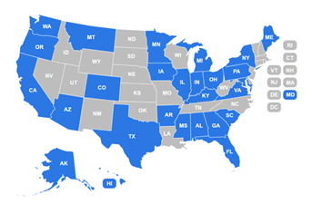
Suicide Prevention Ambassador ECHO
“The ECHO sessions were instrumental in learning the fundamentals of creating community partnerships”
- Suicide Prevention Ambassador ECHO cohort 1 Participant
95 Ambassador ECHO Attendees
32 Media & Advocacy ECHO Attendees
Post-Session
94% (n=87) of the ambassadors reported increased knowledge in the skills taught on the ECHO
86% (n=87) of the ambassadors reported an increase in confidence in their ability to apply the skills taught on the ECHO

Slide 35
Ambassador ECHO Cohort Overview
Community
Advocacy and Policy
Engaged multidisciplinary community suicide prevention experts and individuals with lived experience
Curriculum centered around building participant capacity surrounding community suicide prevention strategies
Engaged AAP Public Affairs, AFSP Public Relations/Writing Outreach Staff, and AAP Spokesperson
Curriculum centered around improving participant self-efficacy related to suicide prevention media and advocacy opportunities
Notes:
This slides gives a brief overview of the community and advocacy/policy ECHO cohorts of our Suicide Prevention Ambassador ECHO, including the types of faculty we engaged and what the curriculum covered. In our community ECHO cohorts, we engaged groups of multidisciplinary community suicide prevention experts and individuals with lived experience. Engaging individuals with lived experience was essential to translate the curriculum’s content to the efforts that AAP and AFSP Suicide Prevention Ambassadors were collaborating on. The curriculum centered around building participant capacity surrounding community suicide prevention strategies, including building and maintaining community partnerships. In the Advocacy and Policy ECHO cohort, we engaged Public Affairs and Public Relations staff from each of our organizations. These folks are on the front lines of advancing our national advocacy and policy agendas. We also invited an AAP Spokesperson to share insights on local and national media engagement. This cohort’s curriculum centered around improving participants’ self-efficacy related to suicide prevention media and advocacy opportunities.

Slide 36
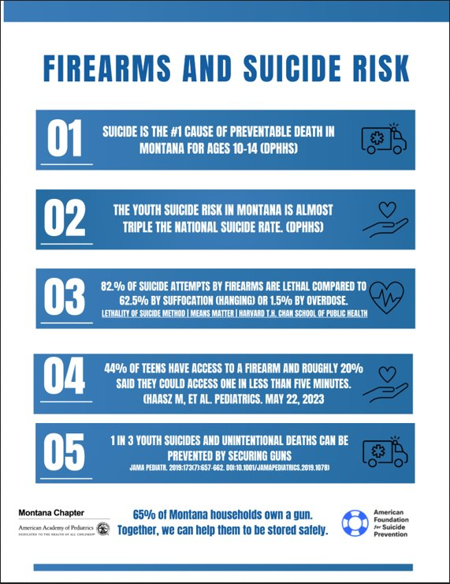

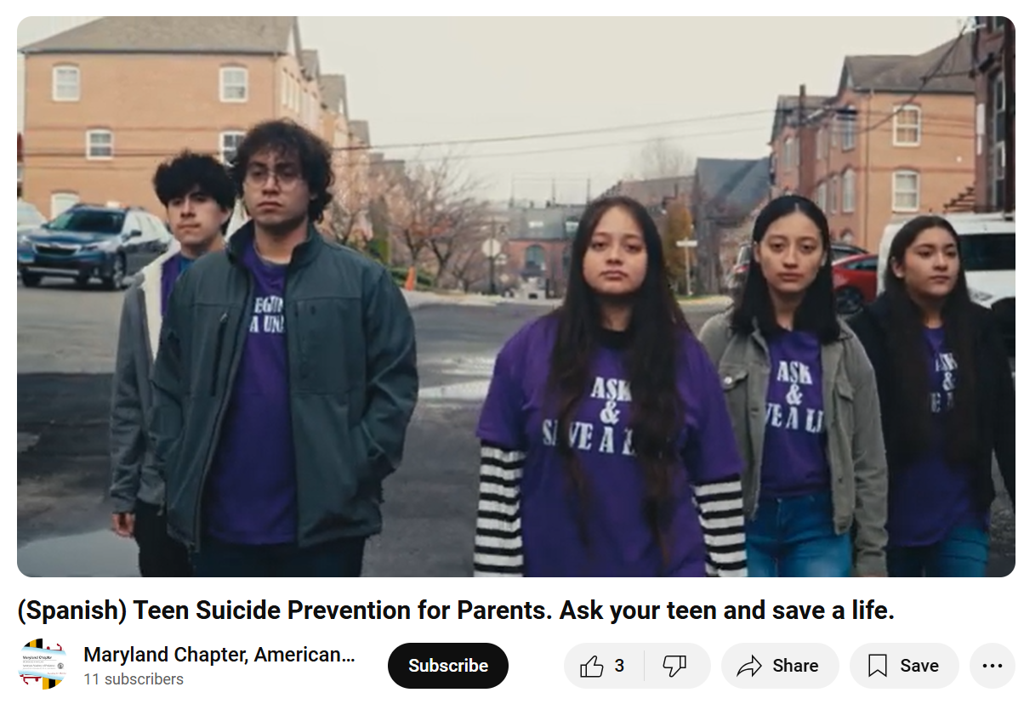
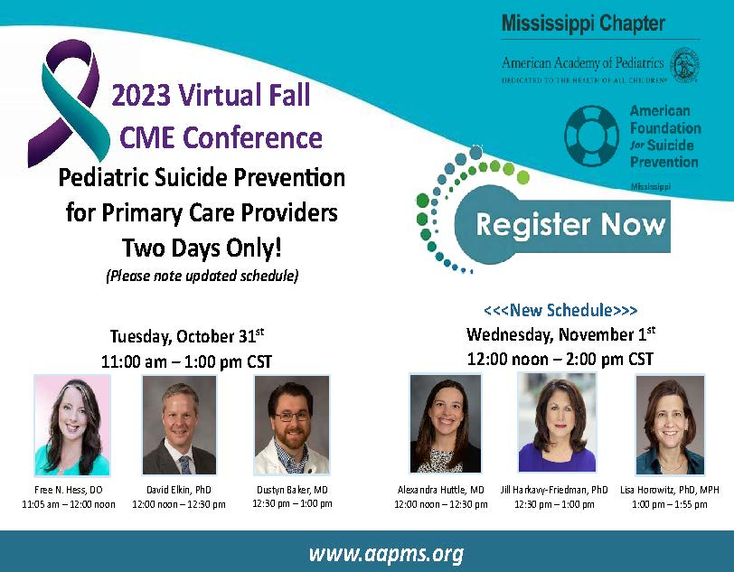
Deepening Community Partnerships
Notes:
In addition to the monthly ECHO sessions, AAP Suicide Prevention Ambassadors were paired by state or territory with AFSP Suicide Prevention Ambassadors and developed a chapter-level Action Plan consisting of measurable goals and activities to be achieved over a period of 12 months. Supported by a grant to the AAP chapter, the purpose of the Action Plan was for Ambassador teams to better understand who the youth are in their communities, identify community partners to support them, and collaborate to leverage current clinical and community networks to expand the reach of their efforts.
From left to right: The Montana AAP and AFSP team knew that most households in their state owned a firearm, and so they developed co-branded messages focusing on the role of secure firearm storage in preventing youth suicide. These messages were shared over both chapters’ social media platforms to widen their reach. The South Carolina AAP chapter hosted a networking event for local pediatricians and mental/behavioral health professionals to increase knowledge of each other’s services, and to support relationship-building across these professionals. Next, Maryland AAP connected with a local organization to recruit Spanish-speaking youth to participate in two youth suicide prevention videos that are available on the Maryland AAP YouTube page. Youth feedback was incorporated into the script development. Finally, Mississippi AAP and AFSP partnered to host a virtual CME conference on pediatric youth suicide prevention for primary care providers in the state. All of this was possible because of the Suicide Prevention Ambassador program.

Slide 37
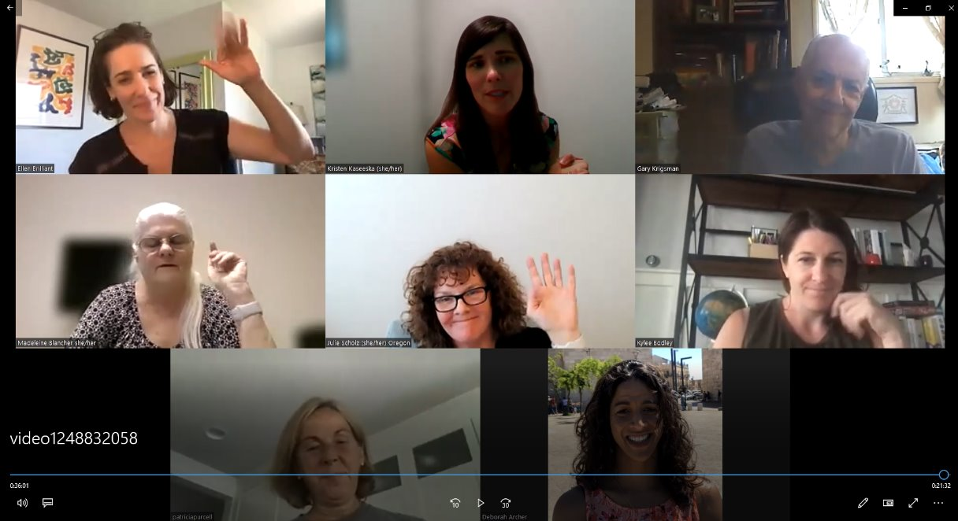


Staying Connected
“Share the programs and priorities that each [AAP and AFSP] organization is working on, focus on both the strengths that each org brings and areas where there is room for growth.”
“Take advantage of the resource information on the collaboration site”

Slide 38
Evaluation Approach
Quality Improvement Metrics
Participant Surveys
Key Informant Interviews
Mixed-methods evaluation design to evaluate the learning objectives and outcomes.
  Key informant interviews and focus groups to collect qualitative data related to peer support, sense of community, and program perception.
  Participant surveys to evaluate gains in knowledge, attitude change, and intended behavior change.
  Quality improvement metrics to measure changes in clinical practice and relevant patient health outcomes.
Together, these three components will result in rich evaluation data at multiple levels.

Slide 39
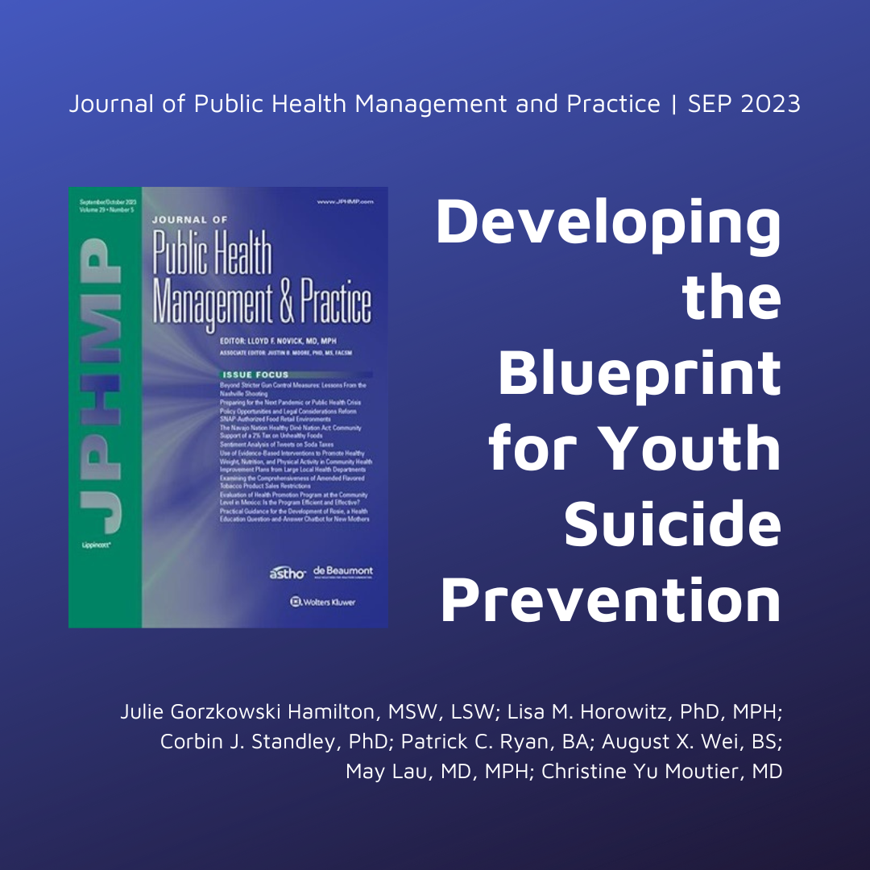
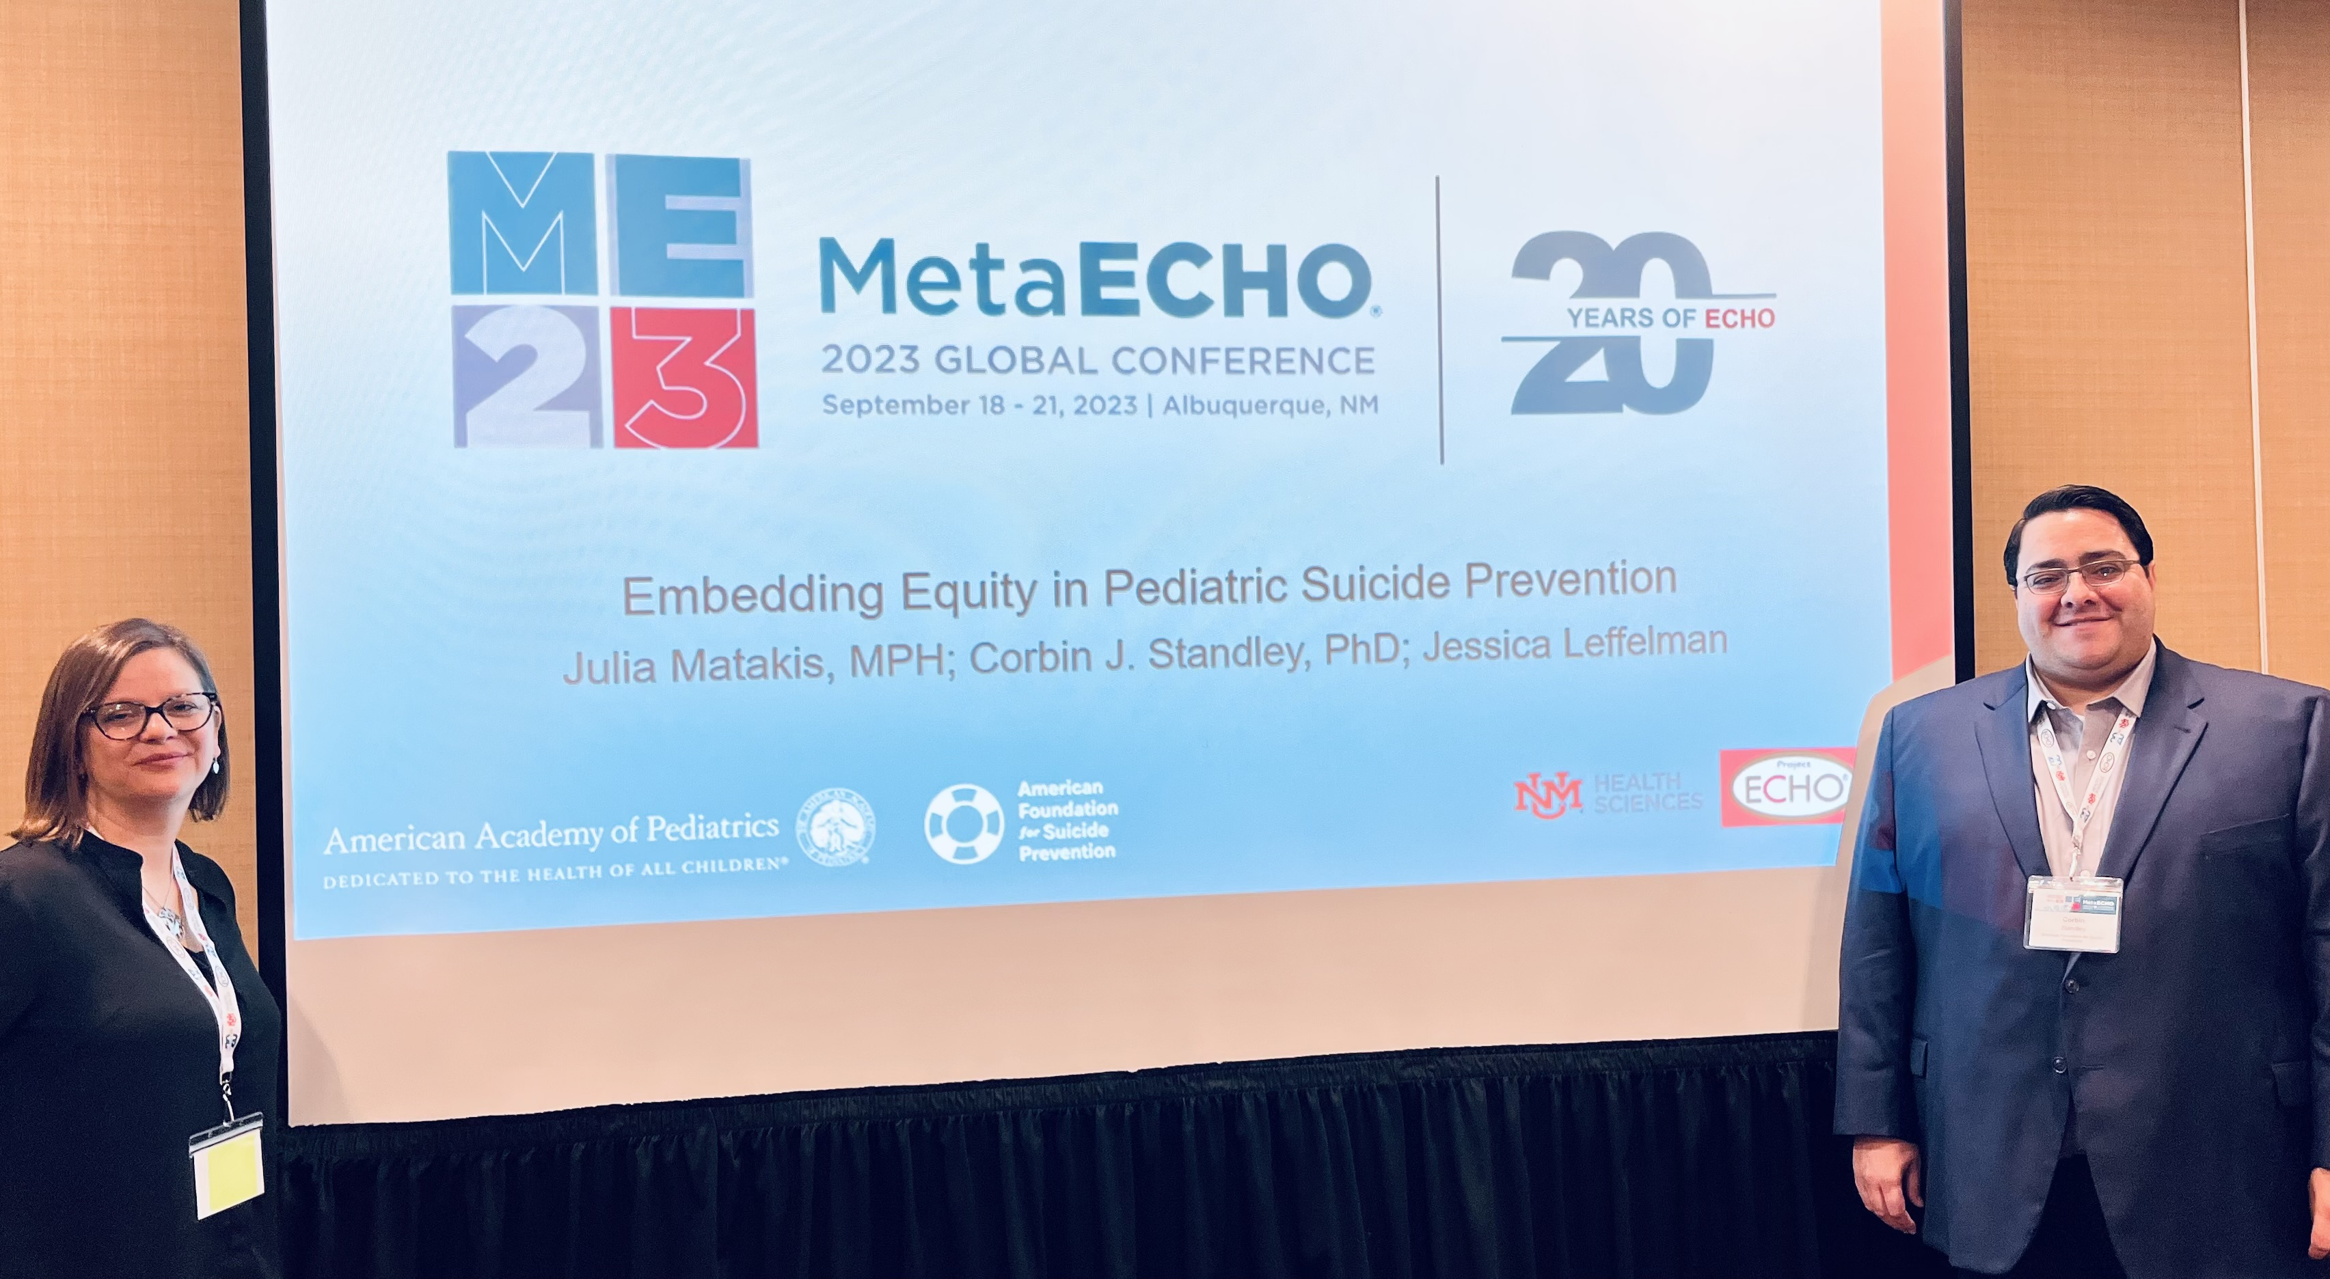
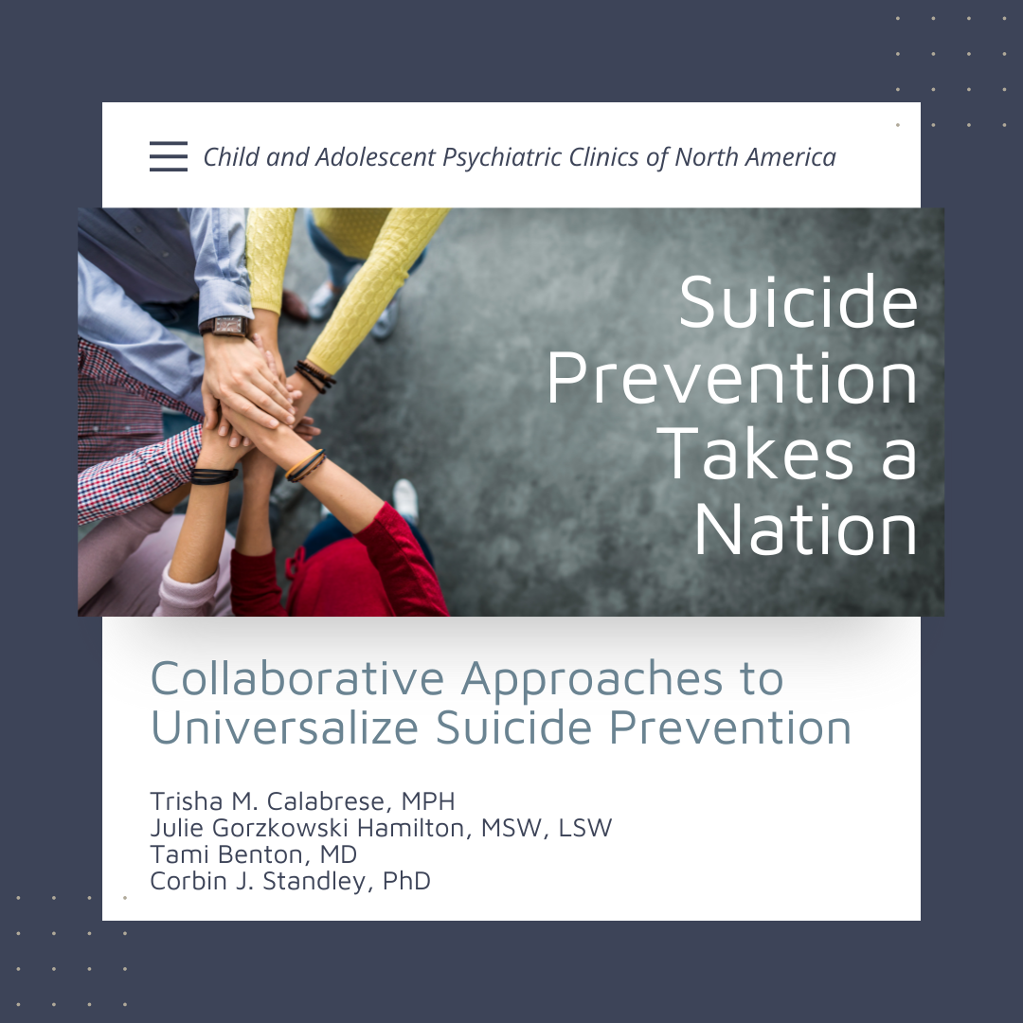
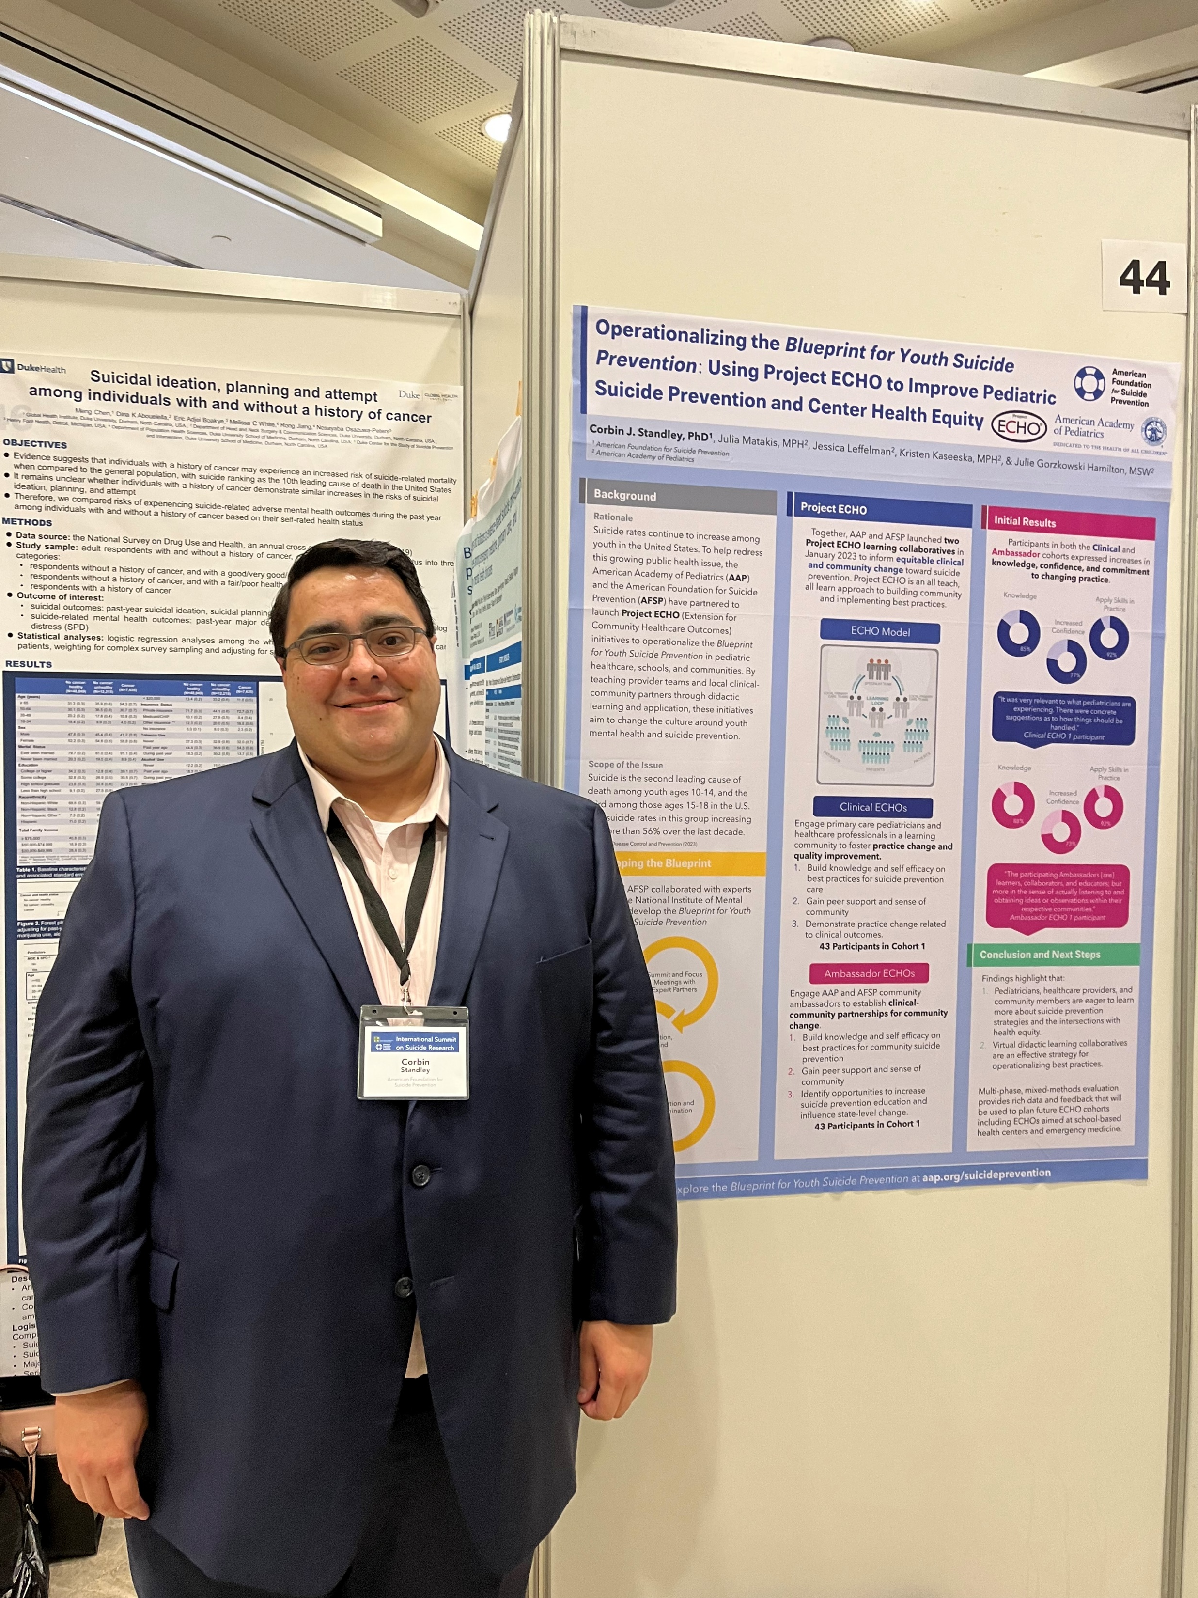
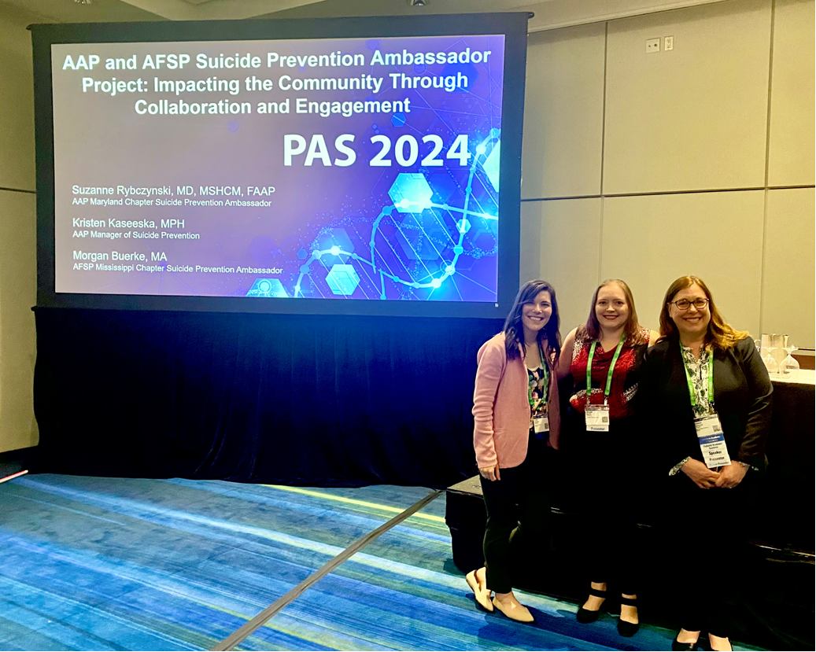
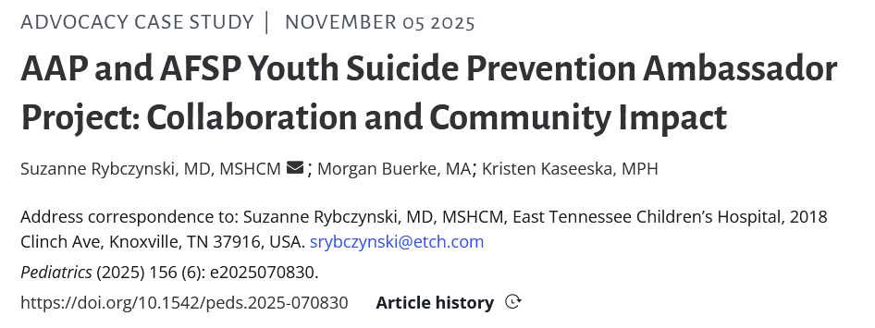

Communicating Impact
Sharing the Blueprint, ECHO development, and impact through multiple mediums to diverse audiences.
Notes:
A key part of public health communication is communicating via multiple mediums to diverse audiences. Through our partnership, we have been very intentional about sharing the Blueprint, the development and adaptations to the clinical and ambassador ECHOs, and the impact of our ECHOs across the country. Through academic publications and conferences reaching providers and researchers, to blog posts and traditional media reaching youth and families, our goal is to make sure this information is reaching every context in which youth live, learn, work, and play.

Slide 40
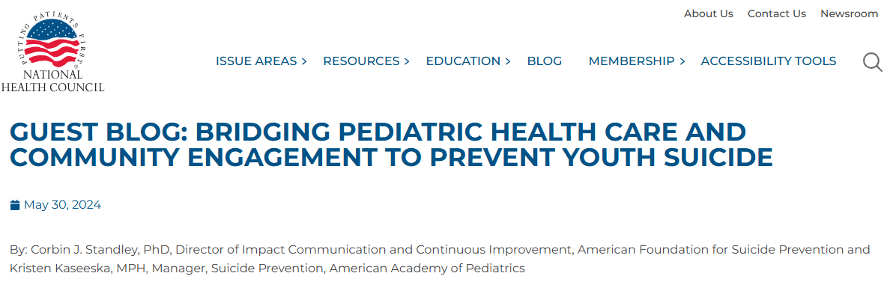

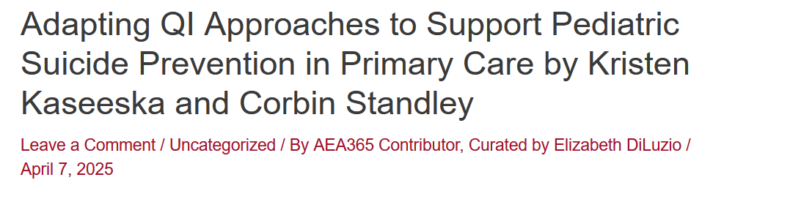
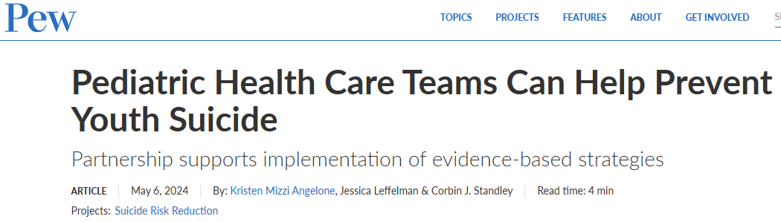
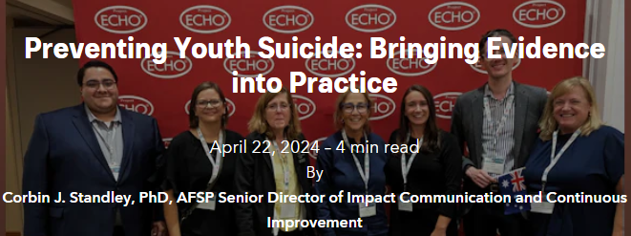
Communicating Impact (cont.)
Sharing the Blueprint, ECHO development, and impact through multiple mediums to broad audiences.
Traditional Media
Blogs
Notes:
A key part of public health communication is communicating via multiple mediums to diverse audiences. Through our partnership, we have been very intentional about sharing the Blueprint, the development and adaptations to the clinical and ambassador ECHOs, and the impact of our ECHOs across the country. Through academic publications and conferences reaching providers and researchers, to blog posts and traditional media reaching youth and families, our goal is to make sure this information is reaching every context in which youth live, learn, work, and play.

Slide 41
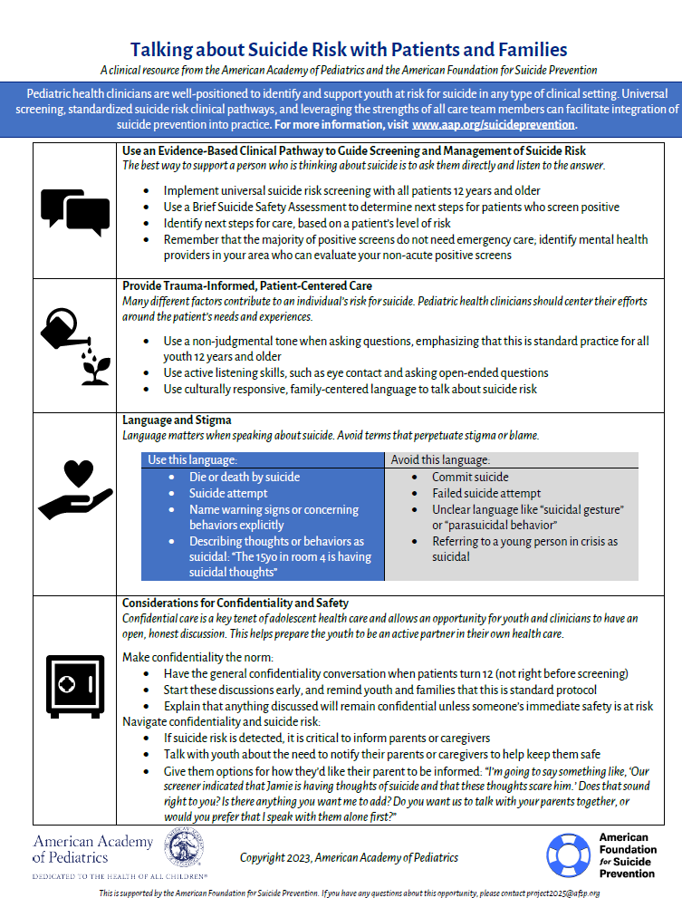


Supporting Implementation
Bringing the strategies described in the Blueprint to interest holders
Find these and more at www.aap.org/suicideprevention/additionalresources
Notes:
In addition to communicating impact, AAP and AFSP have co-developed resources for the many interest holders who support youth suicide prevention. This includes clinical resources designed for pediatric health clinicians, parents and caregivers, and youth themselves. We’ve been thoughtful to create resources that meet our audiences where they are at. For example, many clinical resources available on AAP.org are in a format that is compatible with mobile tablets because we know busy clinicians need information quickly. Resources for families are developed using an 8th grade reading level and starting in 2024, included the perspectives from youth leaders who partnered with AAP in 2024 to serve as advisors to suicide prevention resources and messaging. That includes the middle resource for parents and caregivers about the importance of screening for suicide risk in primary care. Finally, our resources for youth focus on normalizing

Slide 42

We’re always prepared for the asthma attack or seizure or a kid who isn’t breathing. Now we have a mechanism for assessing suicide risk and feel more confident managing these critical encounters.
Dr. Edward Salzberg
Clinical ECHO Participant

Slide 43
Lessons Learned
Operationalizing clinical best practices means supporting providers in translating principles into day-to-day practice (moving from what to how).
Training combined with technical assistance can build capacity of learners to identify and support youth at risk for suicide, and advance youth suicide prevention in community settings.
Being adaptable to change while meeting the needs of learners makes content more relevant and engagement more likely.
Grounding practices and implementation in health equity ensures diverse patient needs are met.

Slide 44
Q&A

Slide 45
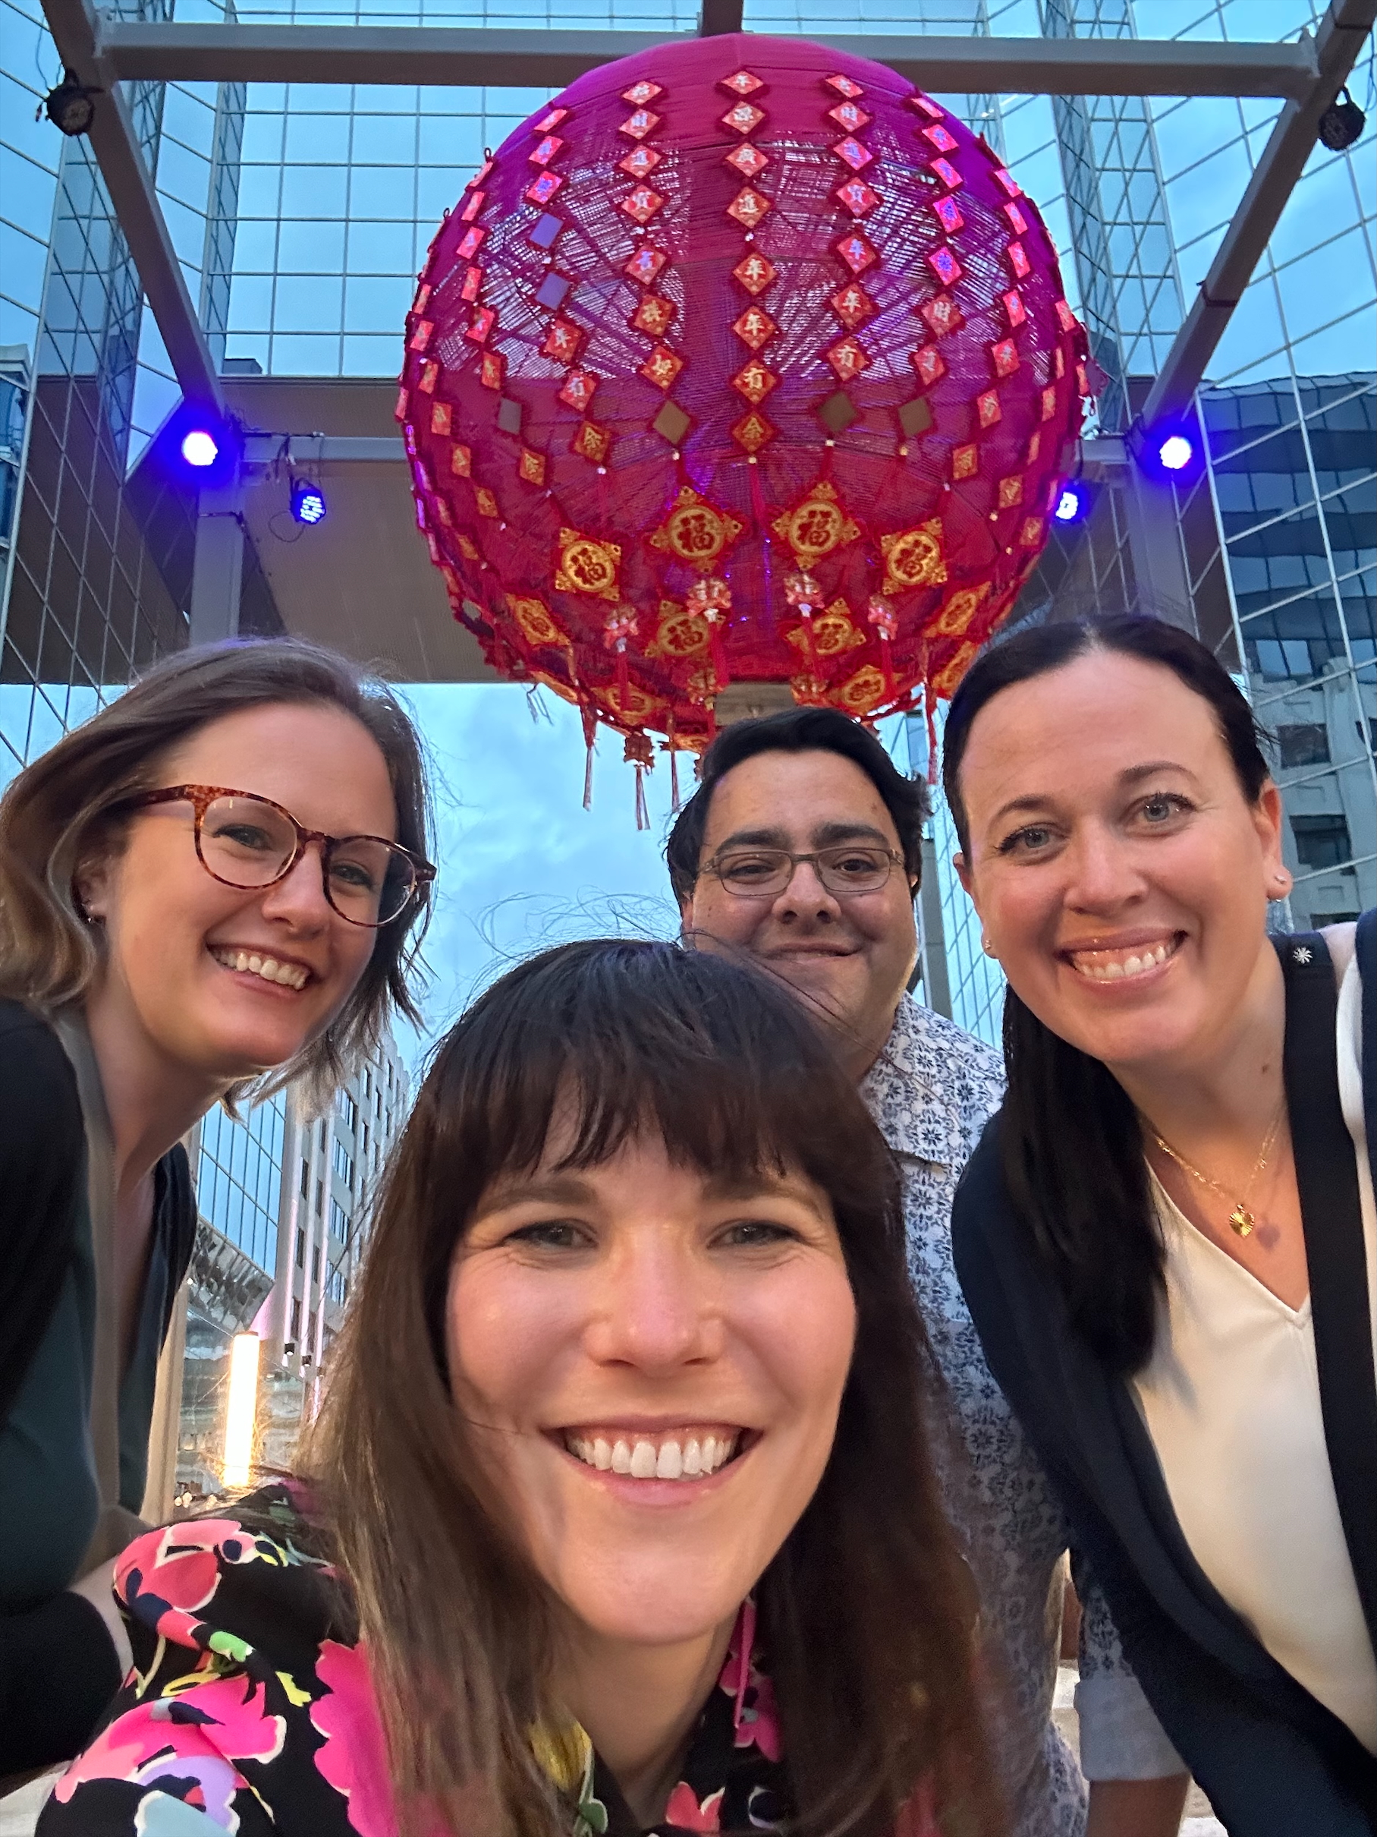
Thank You!

Slide 46

AAP ECHO Publications
& Articles
Impact of Project ECHO on Community ED Providers' Perceptions of Child Abuse Knowledge and Access to Subspecialists for Child Abuse and Neglect
Paper describes how Project ECHO was used to create a virtual community of practice for child maltreatment experts and community emergency department providers across the state who had limited access to consultation.
November-December 2019
Tiyyagura et al
Integrating Quality Improvement into the ECHO Model to Improve Care for children and Youth with Epilepsy
A Quality Improvement Learning Collaborative for Human Papillomavirus Vaccination
This research paper detailing the application of the ECHO model in integrating quality improvement (QI) strategies into the AAP Care for Children with Epilepsy ECHO programs.
This manuscript explores the results of how the AAP utilized Project ECHO and quality improvement methods to increase human papillomavirus (HPV) vaccination rates within pediatric practices.
October 2020
Oliver et al
August 2020
Joshi et al
Project ECHO Telementoring Program Marks Milestones, Looks Toward Future
AAP News article that highlights how project ECHO is being used at the AAP to help pediatric provides increase quality of care for children.
October 2021
The Power of Connections: AAP COVID-19 ECHO Accelerates Responses During a Public Health Emergency
An Innovative Approach to Increase Lead Testing by Pediatricians in Children, United States, 2019–2021
The research report outlines how the AAP rapidly launched ECHO programs designed to increase child health professionals' knowledge, skills, and self-efficacy during the COVID-19 pandemic and the impact of this work.
This peer-reviewed research article outlines how the AAP used the ECHO model to increase understanding and implementation of federal, state, and local blood lead testing and reporting requirements. The project provided interpretative guidance for the use of the CDC blood lead reference value among pediatricians and their teams and addressed barriers such as lack of awareness and logistical challenges by providing educational resources, testing kits, and support to pediatric practices.
January/February 2022
Bernstein et al
September 2022
Calabrese et al
Project ECHO Implementation Profiles
Addressing Emerging Needs Through the COVID-19 and Children With Medical Complexity ECHO
Leveraging telehealth to provide equitable pediatric mental health care
This report, funded by the Robert Wood Johnson Foundation and led by Diffusion Associates, explores the implementation and adaptation of Project ECHO. The AAP ECHO Superhub is a key feature of this reports, summarizing our unique implementation insights, model adoption, funding and leadership structure, and sustainability efforts.
The article takes a deeper
dive into the AAP National Rural Adolescent and Child Health (NRACH) ECHO Training Center and highlights how the center is helping the pediatric community in rural areas using Project ECHO.
The research report outlines how the AAP rapidly launched ECHO programs designed to increase child health professionals' knowledge, skills, and self-efficacy during the COVID-19 pandemic and the evaluation results.
February 2023
January 2024
Boothby et al
August 2024

Slide 47
Curriculum: Primary Care
Topic | Learning Objectives
Addressing Suicide Prevention in Pediatric Practice | Understand the importance of integrating suicide prevention protocols in pediatric primary care settings Learn epidemiology and inequities related to suicide risk among youth Understand clinical pathways to detect and manage youth suicide risk Providing culturally responsive care, including the power of connection and healing
Screening for Youth Suicide Risk in Practice | Understand AAP recommendations for youth suicide prevention in pediatric practice Identify validated screening tools Learn how to talk to patients and families about suicide risk in a culturally responsive, family-centered way, including providing trauma informed care, addressing confidentiality, and addressing language, stigma, and myths Understand the difference between suicide risk screening and assessment
Conducting a Brief Suicide Safety Assessment (BSSA) | Learn why it is important to determine level of suicide risk Understanding how the BSSA further triages the results of a validated screening tool Learn how to respond to a BSSA result in a culturally responsive, family-centered way Learn about tools that can be used to assess risk of suicidal ideation or behaviors in patients
Brief Interventions That Can Make a Difference | Learn how to talk to patients and families about safety planning and lethal means safety counseling Understand how to connect families with support and resources Learn about a “Caring Contact” brief intervention and how to feasibility implement in clinical care Understand when and how to access more urgent care for a young person at risk for suicide
Providing Appropriate Care for Youth at Risk | Learn how to care for youth who are at imminent risk for suicide in a culturally responsive, family-centered way Learn how to care for youth who need further mental health evaluation in a culturally responsive, family-centered way Learn how to care for youth who are at low risk of suicide in a culturally responsive, family-centered way Learn how to facilitate a trusting and open clinical discussion and relationship with a youth patient
Resources and Support | Learn how to identify mental health resources in your community Understand alternatives to emergency care Learn about partnering with pediatric mental health care access (PMHCA) programs Learn how to engage diverse community partners
Addressing Common Implementation Barriers | Learn how to navigate time and resource limitations Supporting families in connecting to resources in a culturally responsive, family centered way Learn self-care strategies to support the mental health of primary care clinicians supporting youth in primary care settings Learn strategies to help overcome potential roadblocks, including integration of telemedicine and utilization of EHR tools and functionalities
Preparing Your Practice for a Suicide Prevention Protocol | Understand how to prepare your health system for a suicide prevention program Understand how to implement strategies learned through a QI process Identify strategies to sustain suicide prevention efforts Considerations for clinicians who have lost a patient to suicide

Slide 48
Curriculum: Emergency Medicine
Topic | Learning Objectives
Addressing Suicide Prevention in Emergency Department Settings | Understand the importance of integrating suicide prevention protocols in emergency department settings Learn epidemiology and inequities related to suicide risk among youth Discuss why universal screening in an emergency department is a critical step in suicide prevention Understand clinical pathways to detect and manage youth suicide risk without overburdening the busy emergency department milieu Identify ways to provide culturally responsive care, including understanding the role of connection and healing
Screening for Youth Suicide Risk in Emergency Department Settings | Understand AAP recommendations for suicide screening Identify validated suicide screening tools that can be used in emergency department settings Learn how to talk to patients and families about suicide risk in a culturally responsive, family centered way, including trauma informed care and ACEs, confidentiality, and language, stigma, and myths Understand the difference between screening and assessment Describe suicide prevention ​education​​ ​and training for all emergency department staff
Conducting a Brief Suicide Safety Assessment (BSSA) | Learn why it is important to determine level of suicide risk Understanding how the BSSA further triages the results of a validated screening tool Learn how to respond to a BSSA result in a culturally responsive, family centered way Learn about tools that can be used to assess risk of suicidal ideation or behaviors in patients
Providing Appropriate Care​ in the Emergency Department Setting ​ for Youth at Risk ​for Suicide​ | Learn how to care for youth who are at imminent risk for suicide in a safe and culturally responsive, family centered way Identify ways to care for youth boarding in emergency departments awaiting further treatment, such as inpatient psychiatric care or transportation to a mental health facility Learn how to care for youth who need further mental health evaluation in a culturally responsive, family centered way Learn how to facilitate a trusting and open clinical discussion and relationship with a youth patient ​Learn how to navigate the number of mental health cases in emergency department settings and wait time limitations​
Planning a Safe Discharge from the Emergency Department | Learn how to talk to patients and families about safety planning and lethal means safety counseling Understand how to connect families with support and resources, including access to community and crisis resources such as 9-8-8 Learn about a “Caring Contact” brief intervention and how to feasibility implement in clinical care Learn how to identify mental health resources in your community Understand referral options for inpatient and outpatient care Learn about partnering with pediatric mental health care access programs Learn how to engage diverse community partners as is feasible
Preparing Your Emergency Department Setting for a Suicide Prevention Protocol | ​​Understand how to prepare your health system for a suicide prevention program, including integration of a clinical pathway for suicide prevention ​​​Develop strategies to care for increasing numbers of patients with mental and behavioral health emergencies while​​ considering limited resources and overall patient flow in the emergency department​​ Understand how to implement strategies learned and sustain efforts Considerations for clinicians who have lost a patient to suicide Learn strategies to help overcome potential roadblocks, including utilization of EHR tools and functionalities

Slide 49
Curriculum: School-based Health Care
Topic | Learning Objectives
Addressing Suicide Prevention in School-Based Settings | Understand the importance of integrating suicide prevention protocols in school-based settings Learn epidemiology and inequities related to suicide risk among youth, including risk factors and protective factors Describe the multi-tiered system of supports (MTSS) approach to address youth suicide prevention
Comprehensive Suicide Prevention in Schools: Intervention Component | Understand AAP recommendations for youth suicide prevention in pediatric practice Identify validated screening tools Learn how to talk to patients and families about suicide risk in a culturally responsive, family-centered way, including providing trauma informed care, addressing confidentiality, and addressing language, stigma, and myths Understand the difference between suicide risk screening and assessment
Comprehensive Suicide Prevention in Schools: Prevention Component | Learn why it is important to determine level of suicide risk Understanding how the BSSA further triages the results of a validated screening tool Learn how to respond to a BSSA result in a culturally responsive, family-centered way Learn about tools that can be used to assess risk of suicidal ideation or behaviors in patients
Creating Trauma-Informed Crisis Teams / Obstacles | Learn how to talk to patients and families about safety planning and lethal means safety counseling Understand how to connect families with support and resources Learn about a “Caring Contact” brief intervention and how to feasibility implement in clinical care Understand when and how to access more urgent care for a young person at risk for suicide
Comprehensive Suicide Prevention in Schools: Postvention Component | Learn how to care for youth who are at imminent risk for suicide in a culturally responsive, family-centered way Learn how to care for youth who need further mental health evaluation in a culturally responsive, family-centered way Learn how to care for youth who are at low risk of suicide in a culturally responsive, family-centered way Learn how to facilitate a trusting and open clinical discussion and relationship with a youth patient
Community Partner Impact and Social Media Considerations | Learn how to identify mental health resources in your community Understand alternatives to emergency care Learn about partnering with pediatric mental health care access (PMHCA) programs Learn how to engage diverse community partners

Slide 50
Quality Improvement Data Collection
Sample
  Adolescents 12-21 years old
  Seen for a preventive care visit in data collection month
Requirements
  15 patient charts per site per cycle
Timeline
  7 months
Data Submission
  AAP’s Quality Improvement Data Aggregator (QIDA)

Slide 51
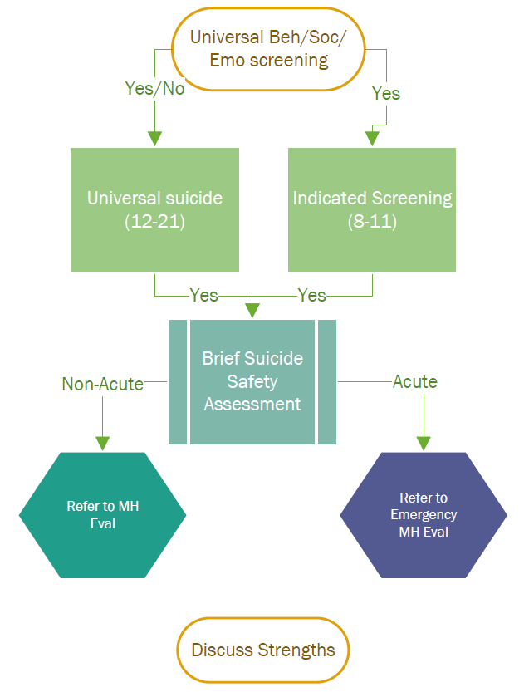
Initial Quality Improvement Metrics
Universal screening
Indicated screening
Brief Suicide Safety Assessment
Refer to MH Evaluation
Refer to Emergency MH Evaluation
Discuss Strengths

Slide 52
Publications and blog posts to learn more about Project ECHO in pediatric settings include:
Gorzkowski Hamilton, J., Horowitz, L. M., Standley, C. J., Ryan, P. C., Wei, A. X., Lau, M., & Moutier, C. Y. (2023). Developing the Blueprint for Youth Suicide Prevention. Journal of Public Health Management & Practice, 29(5), E214-E222. https://doi.org/10.1097/PHH.0000000000001764
Calabrese, T., Gorzkowski Hamilton, J., Benton, T.D., & Standley, C. J. (2024). Suicide prevention takes a nation: Collaborative approaches to universalize suicide prevention. Invited paper for special issue of Child and Adolescent Psychiatry Clinics. https://doi.org/10.1016/j.chc.2024.02.003
Standley, C. J. & Kaseeska, K. (2024). Bridging health care and community engagement to prevent youth suicide. [Blog]. National Health Council Putting Patients First Blog. https://nationalhealthcouncil.org/blog/guest-blog-bridging-pediatric-health-care-and-community-engagement-to-prevent-youth-suicide/
Mizzi, K., Standley, C. J., & Leffelman, J. (2024). Pediatric providers can help prevent suicide: Partnership supports health care teams in implementing evidence-based strategies. [Article]. The Pew Charitable Trusts. https://www.pewtrusts.org/en/research-and-analysis/articles/2024/05/02/pediatric-health-care-teams-can-help-prevent-youth-suicide
Standley, C. J. (2024). Preventing youth suicide: Bringing evidence into practice. [Blog post]. American Foundation for Suicide Prevention Real Stories blog. https://afsp.org/story/preventing-youth-suicide
See their abstract to the 2024 Society for Adolescent Health and Medicine “Building Capacity of Pediatric Ambassadors in Community Suicide Prevention Strategies Described in the Blueprint for Youth Suicide Prevention”

