Slide 1
Multi-site Validation Study for Suicide Risk Prediction: Integrating the OHDSI Research Network
CAPES Pilot Project
PI: Feifan Liu
Co-Is: Ben Gerber, Adrian Zai, Celine Larkin
Aim 1
  Build a prototype MHRN-based suicide attempt risk prediction model using the OMOP common data model
    Primary care and mental health specialty settings
Aim 2
  Multi-site validation study (OHDSI network or P50 network) on suicide attempt risk prediction
    Generalization assessment across healthcare institutions
    Fairness assessment across demographic groups (e.g., gender/racial/ethnic subgroups)
Goals: To gain valuable insights on designing and conducting a large-scale validation study of suicide risk predictive modeling, and assess how performance varies across different clinical contexts.

Slide 2
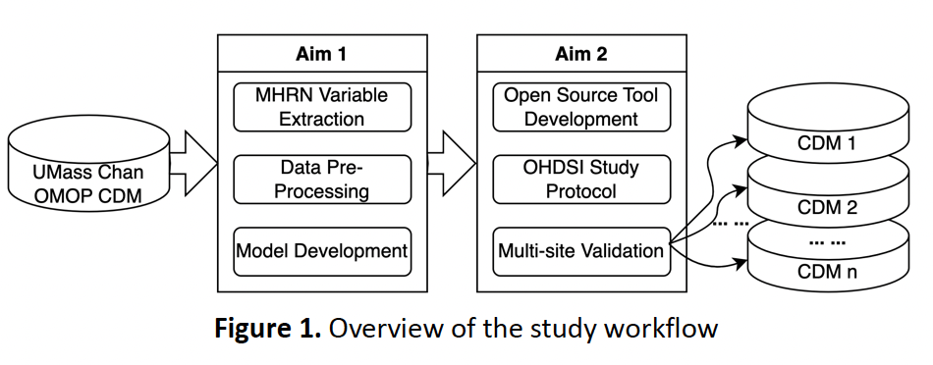
Figure 1. Overview of the study workflow

Slide 3
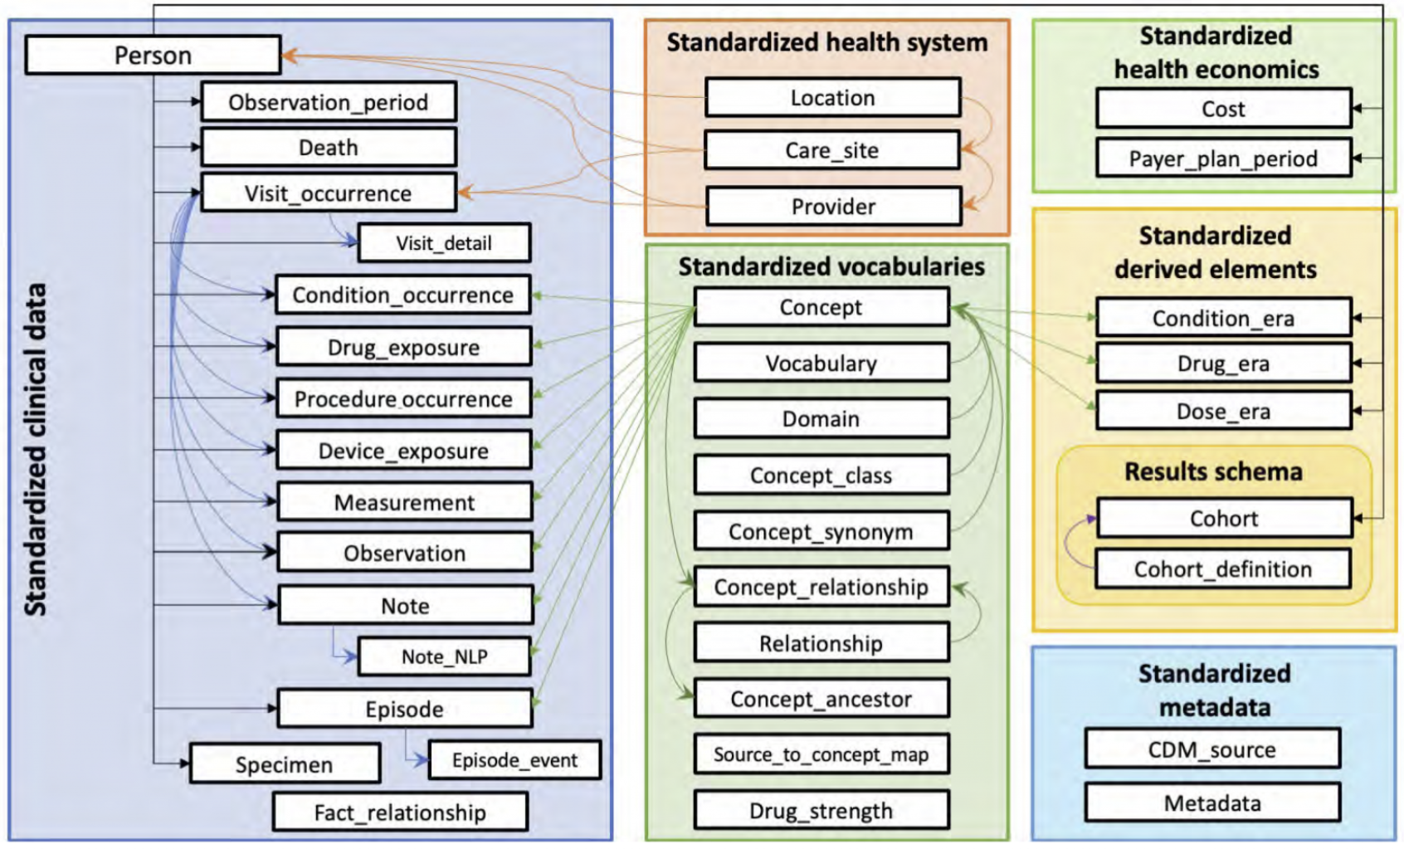
OMOP CDM Database
OMOP Common Data Model Architecture Diagram
https://www.ohdsi.org/data-standardization/

Slide 4
Challenges
Dealing with large volume of medical records
  Computing efficiency
  Memory efficiency
Reproducibility
  Modularized design
Remapping the MHRN features

Slide 5
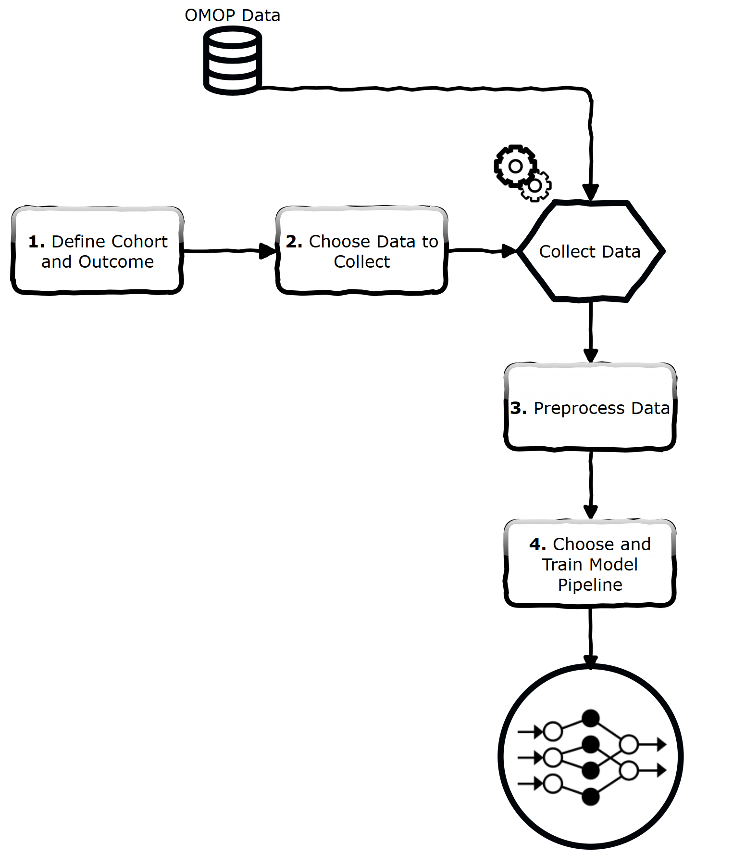
OMOP-Learn
✅Facilitates rapid prototyping
  Predictive ML models on top of OMOP CDM.
⚙️Streamlines the process
  Defining cohorts,
  Extracting features,
  Training models,
📊Enables efficient analysis of
https://clinicalml.github.io/omop-learn/
Notes:
The purpose of omop-learn is to facilitate rapid prototyping of predictive machine learning models using longitudinal healthcare data structured according to the OMOP Common Data Model (CDM). It streamlines the process of defining cohorts, extracting features, and training models, enabling efficient analysis of electronic health records (EHRs) and claims data.

Slide 6





OMOP-Learn Key Features
Cohort and Outcome Definition: Users can specify patient cohorts and outcomes using SQL queries.
Feature Extraction: Supports automatic extraction of time-series features from OMOP-standard tables.
Sparse Tensor Representation: Features are stored in sparse tensor formats, optimizing memory usage and computational efficiency.
Modeling Flexibility: Includes implementations of both linear models and deep learning architectures .
Integration with Python Ecosystem: Designed to integrate seamlessly with Python-based ML and DL libraries.
Notes:
Cohort and Outcome Definition: Users can specify patient cohorts and outcomes using SQL queries, making it easier to define predictive tasks.
Feature Extraction: The library supports automatic extraction of time-series features from OMOP-standard tables, which are essential for predictive modeling.
Sparse Tensor Representation: Features are stored in sparse tensor formats, optimizing memory usage and computational efficiency, especially for large datasets.
Modeling Flexibility: omop-learn includes implementations of both linear models and deep learning architectures, such as the SARD (Self-Attention with Reverse Distillation) model, allowing users to experiment with different modeling approaches.
Integration with Python Ecosystem: The library is designed to integrate seamlessly with Python-based machine learning and data science libraries, supporting tools like scikit-learn, PyTorch, and Hugging Face.

Slide 7
Pipeline based on OMOP-Learn
1. Cohort Creation
2. Process OMOP Tables
3. Extract Temporal Features
4. Extract Non-temporal Features
5. MHRN Mapping
6. Feature Matrix
7. Model Training
8. Evaluation
Notes:
1. Preprocessing Setup
⚙️ Functions Defined:
preprocess_person_dict()
preprocess_visit_list()
load_person_data()
⬇️
2. For Each person_dict
🧍 Process One Person's Record
⬇️
3. Temporal Features Loop
🕒 Temporary Features (tmp_features)
Extract: concept_id, visit_date
Output:
Add to tmp_combined: (prefix_conceptid, date)
Add to concept_set
⬇️
4. Non-Temporal Features Loop
📌 Non-Temporal Features (ntmp_features)
Extract concept_id
Output:
Add to ntmp_combined: (concept_id, prefix_conceptid)
Add to concept_set
⬇️
5. Build Visit Dictionary
📅 Group by Date
visit_dict[visit_date] = [concepts...]
⬇️
6. Store Visits & Dates
📁 Update person_dict:
visits = list(visit_dict.values())
dates = list(visit_dict.keys())
⬇️
7. Store Non-Temporal Fields
📝 Add Fields to person_dict
For each ntmp_combined → person_dict[name] = val
⬇️
8. Return Processed Output
📦 Output Depending on Mode
If is_visit_dataset = False:
→ preprocess_person_dict(person_dict)
If True:
→ preprocess_visit_list(person_dict)
⬇️
✅ Return Tuple:
processed_row
concept_set

Slide 8
Generating Condition Concept_ids
🧬 Condition Concept Mapping
🧾 Input: MHRN Cohort
🔁 Loop through each row
➡️ Extract condition_concept_id
  Anxiety,
  Bipolar,
  Dementia,
  Depression,
  etc.
🕒Define Temporal Features

Slide 9
Generating Demographic Concept_ids
🧬 Demographic Concept Mapping
🧾 Input: MHRN Cohort
🔁 Loop through each row
➡️ Extract concept_ids
  gender_concept_id
  race_concept_id
  ethnicity_concept_id
🛠️ Define Non-Temporal Features

Slide 10
MHRN Example (Diagnosis)
Variable | Description
dep_dx_pre5y_noi_cumulative | Depression DX, (0,5] years prior
dep_dx_pre5y | Depression DX, [1,5] years prior
🔁 For Each Index Visit:
  Get visit date
  Count diagnoses with:
  365 <= (visit_date - condition_start_date).days ≤ 1825 (dep_dx_pre5y)
    dep_dx_pre5y_noi_cumulative: count
    dep_dx_pre5y: 1 if count > 0
🟩 Feature:
  Historical condition frequency & presence

Slide 11
MHRN Example (PHQ-9)
Variable | Description
phqNumber90 | Total PHQ-9 assessments in past 90 days
phqMode90_0/1/2 | Mode of PHQ-9 values in past 90 days (binned)
Source Table: observation
  Use concept ID for PHQ-9 score (e.g., 44810380)
  Extract observation date and value
For Each Index Visit
  Check observation_date in window: 0 < (visit_date - observation_date).days ≤ 90
  Count number of PHQs → phqNumber90
  Find modal (most common) PHQ9 value ->phqMode90
🟩 Feature
  Recent mental health assessment trends

Slide 12
MHRN Example ( Suicide Attempt Outcome)
🎯 Event Flags
  event30 = 1 if suicide attempt within 30 days after index visit else 0
  event90 = 1 if suicide attempt within 90 days after index visit else 0
🟩 Target Outcomes for Binary Classification

Slide 13
Conclusion
✅ Standardized Feature Extraction
  Leverage OMOP-Learn to improve reproducibility and interoperability
🔍 Flexible Feature Definition
  Allows construction of:
    Cumulative risk variables (e.g., dep_dx_pre5y_noi_cumulative)
    Time-proximal flags (e.g., event30, any_sui_att_pre3m)
    Modality-based features (e.g., PHQ9 mode)
📊 Scalable and Parallelized
  Efficient processing of large MHRN cohorts via multiprocessing
  Prepares one-hot encoded feature matrix ready for machine learning
Notes:
✅ Standardized Feature Extraction
OMOP-Learn leverages the OMOP-CDM schema to systematically extract features across multiple clinical domains (conditions, observations, demographics, etc.)
Ensures reproducibility and interoperability across datasets and institutions
🏥 Rich, Temporal Patient Histories
Captures time-windowed events (e.g., suicide attempts, diagnoses, assessments)
Enables modeling of risk over time using both recent and historical data
🔍 Flexible Feature Definition
Allows construction of:
Cumulative risk variables (e.g., dep_dx_pre5y_noi_cumulative)
Time-proximal flags (e.g., event30, any_sui_att_pre3m)
Modality-based features (e.g., PHQ9 mode)
📊 Scalable and Parallelized
Efficient processing of large MHRN cohorts via multiprocessing
Prepares one-hot encoded feature matrix ready for machine learning
🎯 Why It Matters
Suicide is complex and multifactorial
OMOP-Learn enables data-driven identification of high-risk individuals using structured EHR data
Supports early intervention and precision mental health care

Slide 14
Current Status
01
Diagnoses and PHQ9
02
Outcomes
03
Historic Healthcare Utilization
04
Medications + Charlson Index
05
Insurance + Census

Slide 15

THANK YOU

